Slide 1
PHY 303L
Homepage: www.ph.utexas.edu/~itiq/303Lf13/chiu
(UT Physics department)
Resources used in this course:
Syllabus
Lesson plan
Lecture slides
Overview of this course:
Preview the lesson: learning modules (in Quest)
Use of Clickers during the lecture
Use of Quest homework system
TA sessions
4 midterms and 1 final

Slide 2

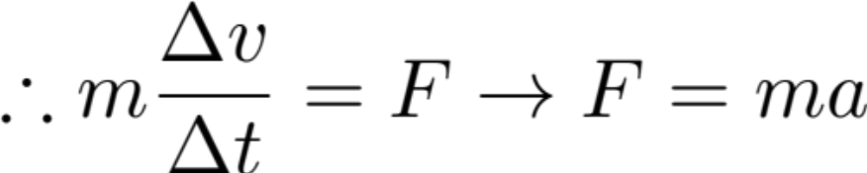
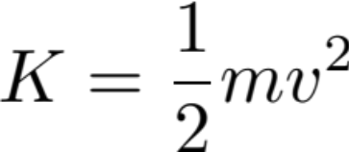
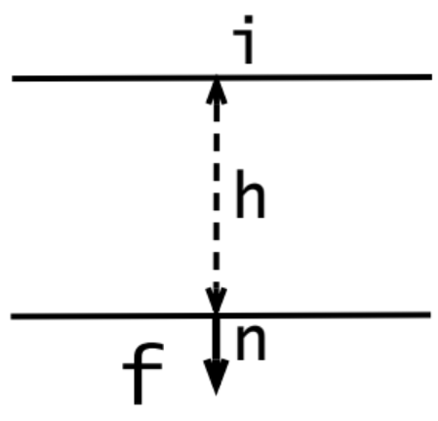

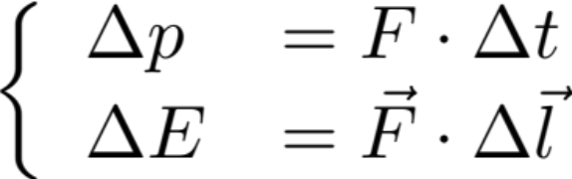
Basic Principles of Mechanics
impulse
Momentum principle:
Nonrelativistic:
Energy Principle:
For 1 massive particle:
Gravity
Path m by height h
Let go at the initial point i
Particle is accelerated with acceleration g
You are ready to study M&I Vol. II: E&M so long as you have the basic knowledge of:
(and their applications)

Slide 3
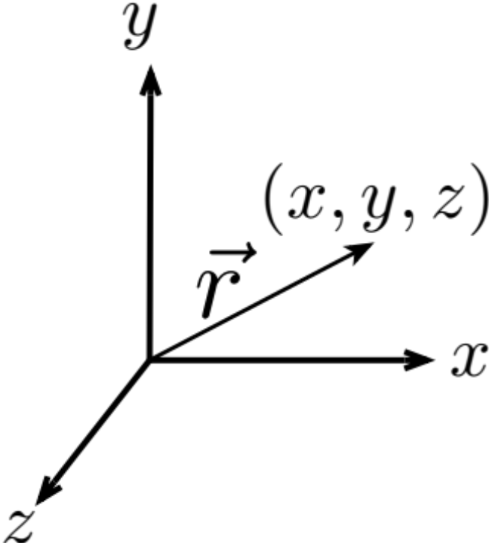

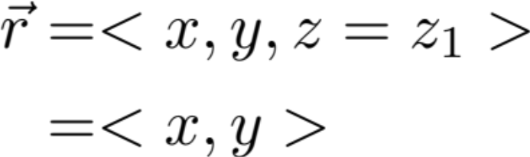
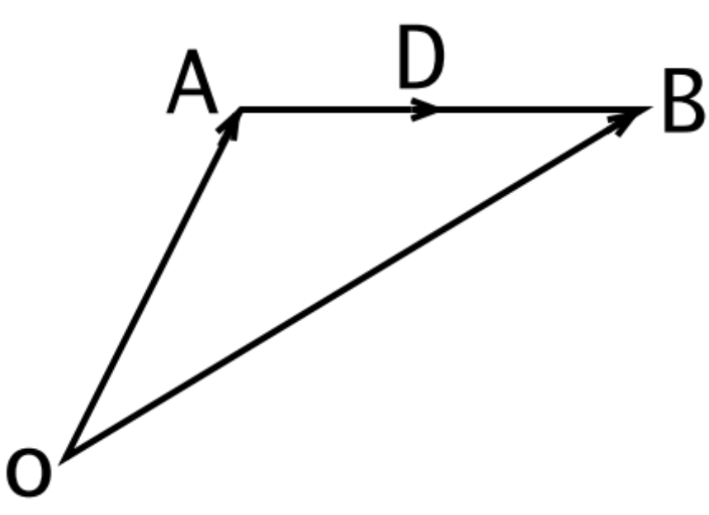

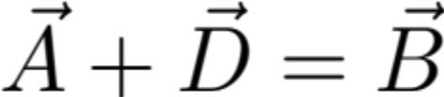
Review Vectors
Vector in 3D:
Vector in 2D:
Displacement Vectors
Intuitive Description:
Starting at A, add D, it ends at B

Slide 4
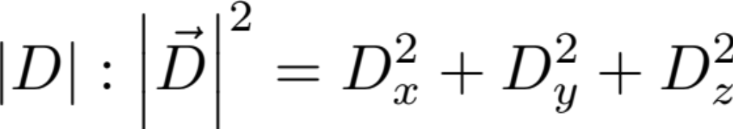
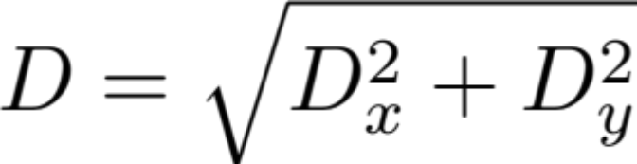
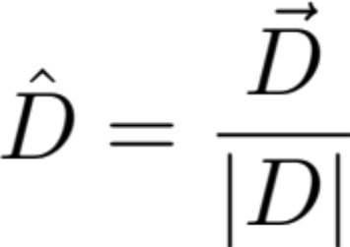
Magnitude
(3D)
(2D)
Unit Vector:
Product of 2 Vectors:
Scalar Product = Dot Product
Vector Product = Cross Product

Slide 5
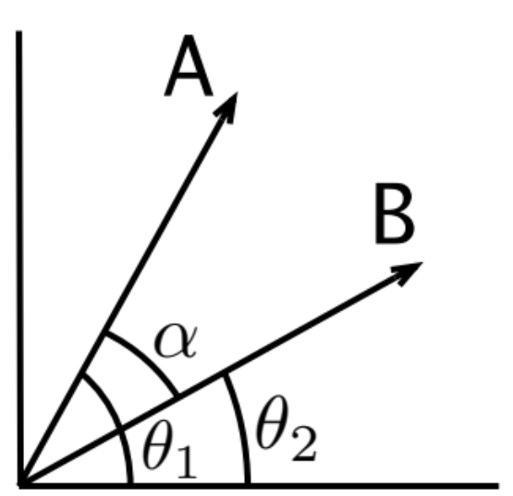
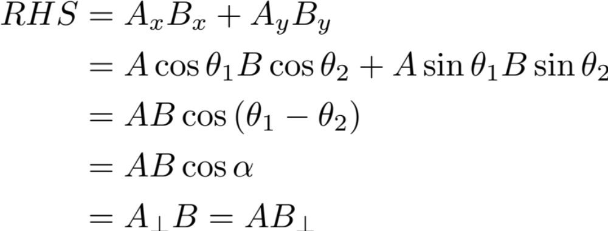
Scalar Product = Dot Product

Slide 6
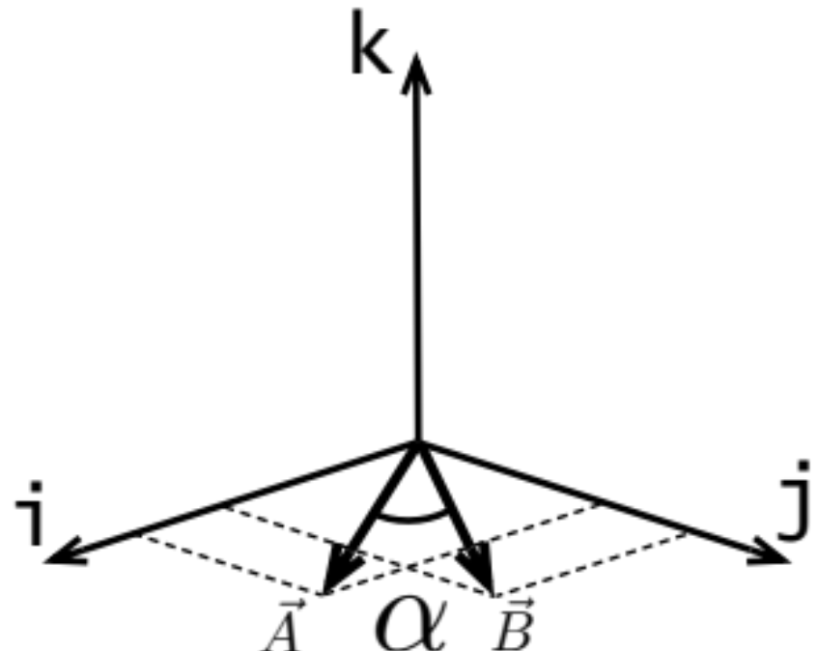

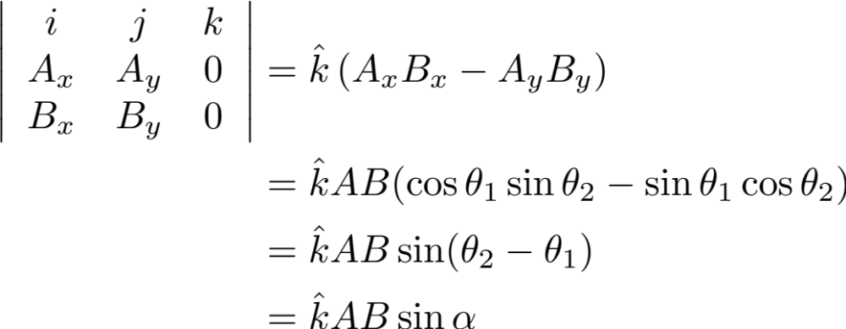
Vector Product = Cross Product

