Slide 1

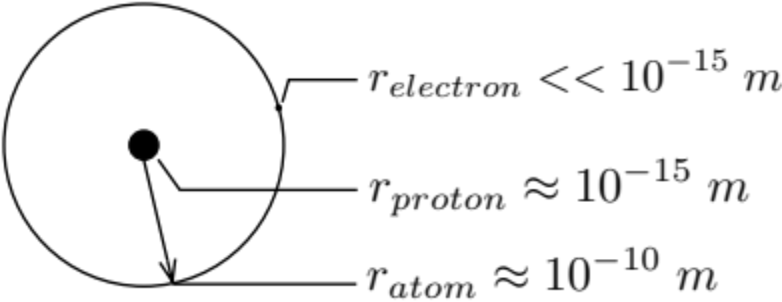
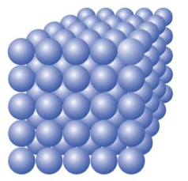

Lecture 2
Electrical Charge. Charge is a property of the building block of matter.
charge
electrons
-1e
Matter -> molecule -> atoms
p
+1e
nucleus
n
0e
Lattice Spacing:

Slide 2
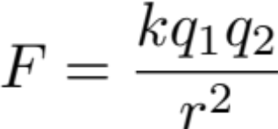
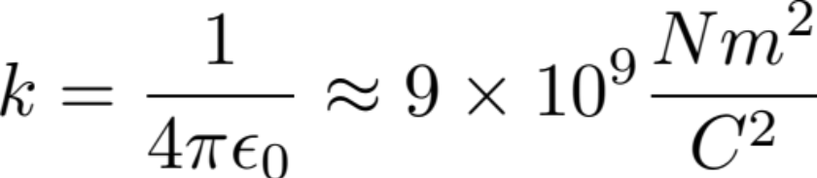
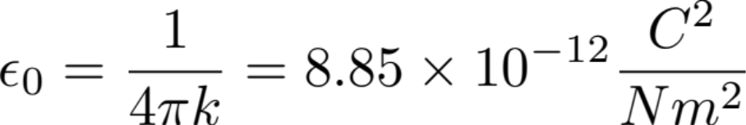
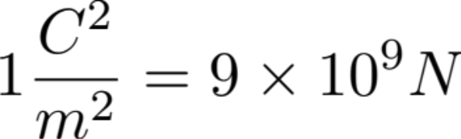
k is the conversion factor:
Electric Field
a. Causal Description
Coulombs law is a description of action at distance.
(acausal description)
A causal description can be achieved in 2 steps.

Slide 3



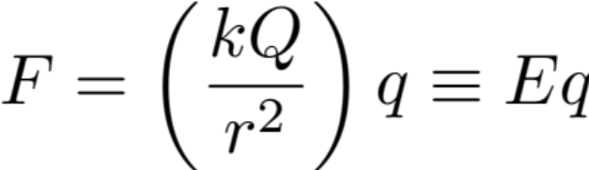
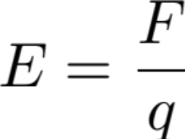

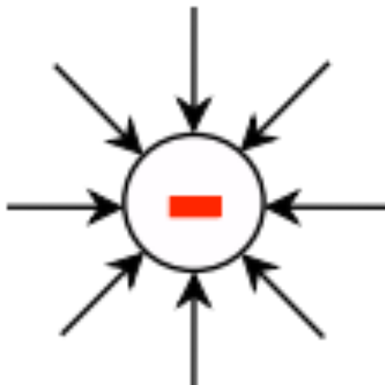
Spider-Fly Analogy
Attraction between spiders and fly
Q
E
q
Source charge
Field
Test charge
Description of the field: Field line
Positive charges a source of field lines
Negative charges a source of field lines

Slide 4
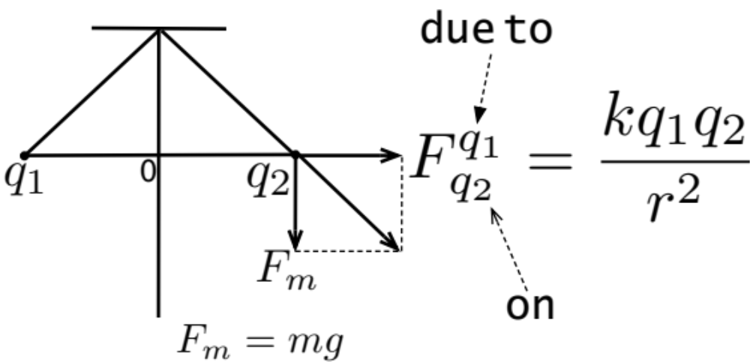
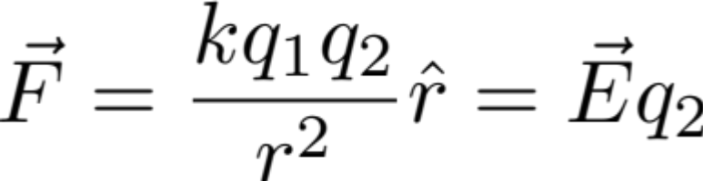
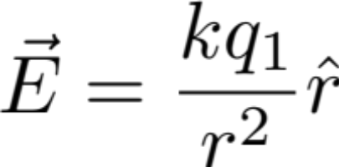
Electric Force Vectors
Combine gravitational force vector with electric force:
Adding electric force vector to gravitational force vector.
Notice E depends on the source charge q1 and the position of the observation point in relation to the source charge, r. E is independent of q2.

