Slide 1
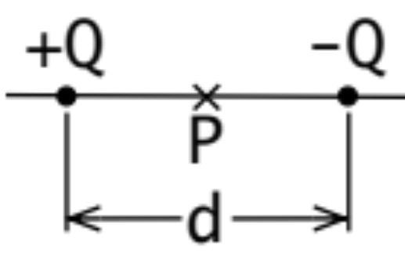
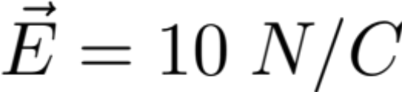

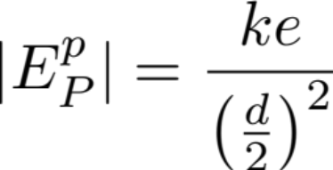
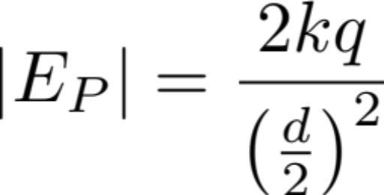
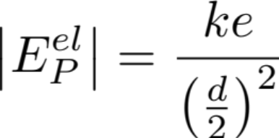
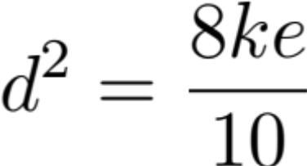
Lecture 3
Super Position Principle
An exercise:
Given electron-proton pair, with charge –Q, +Q, where Q = e, separated by distance d. Find d.
At center P:
Superposition principle: the field at any point equals to the sum of the fields contributed by individual charges.
direction
direction
direction

Slide 2
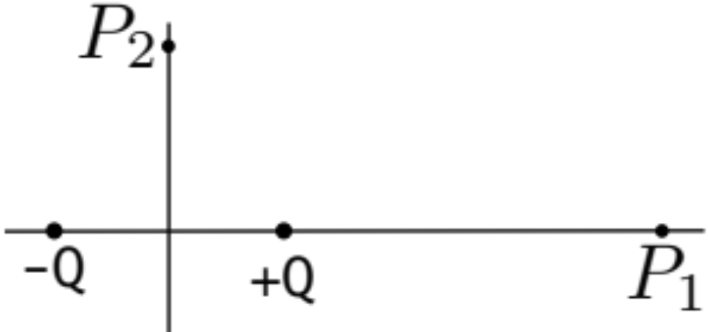
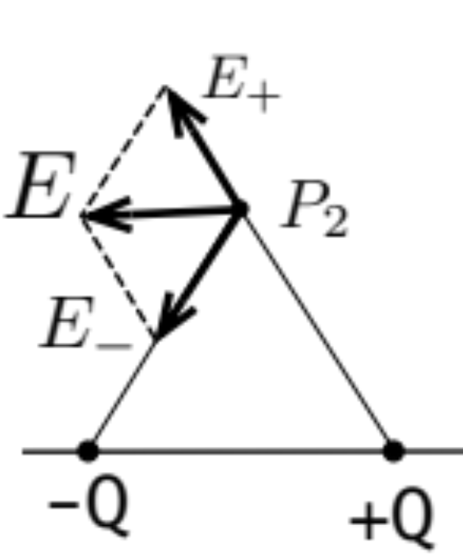
Dipole Field Pattern
At P1: +Q is closer, E
At P2:
E

Slide 3
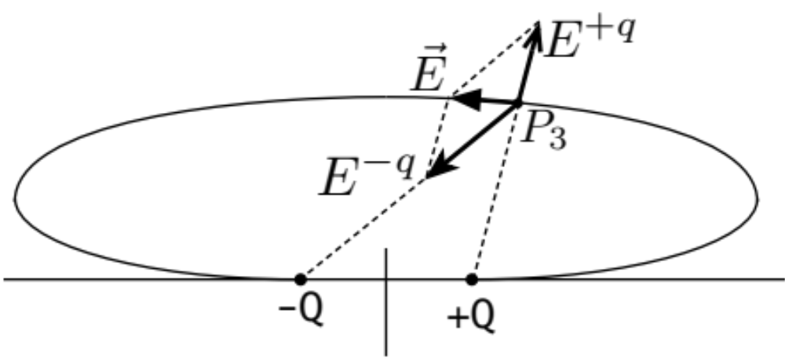

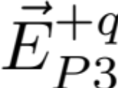
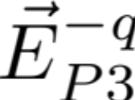

At P3:
By inspection:
Direction of
Exercise: Based on the superposition principle, E is produced along an elliptical curve
Direction of

Slide 4
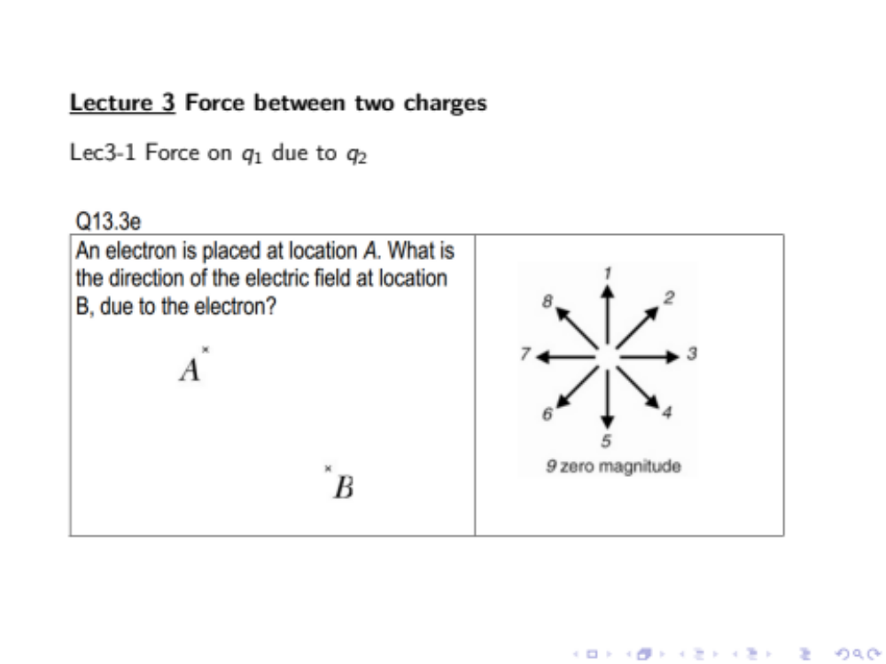
Clicker 3-1

Slide 5
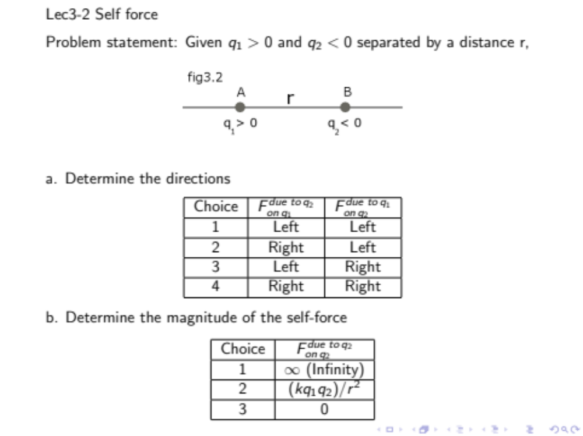
Clicker 3-1: Force due to q1 on q2

