Slide 1
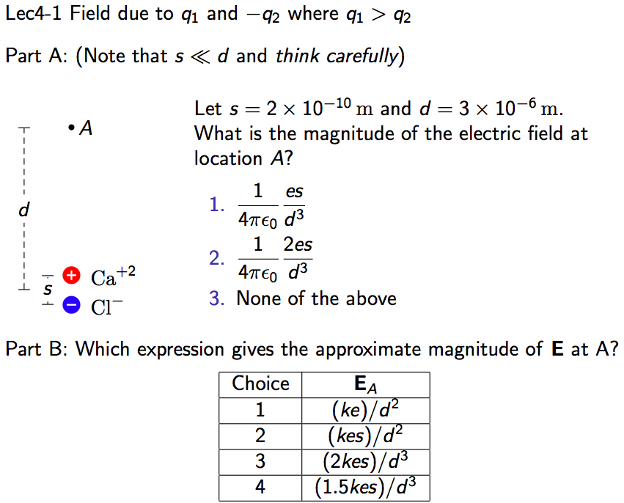
Lecture 5
Revisit dipole field – clicker problem
Dipole System - +/- Q separated by distance s

Slide 2
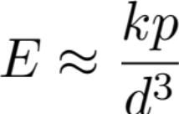
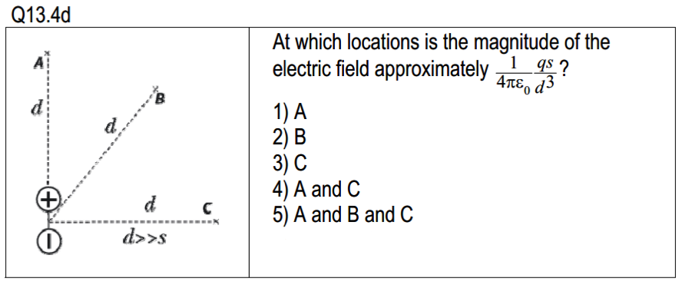
Clicker 5-2
Which location has:
Lec4-4

Slide 3
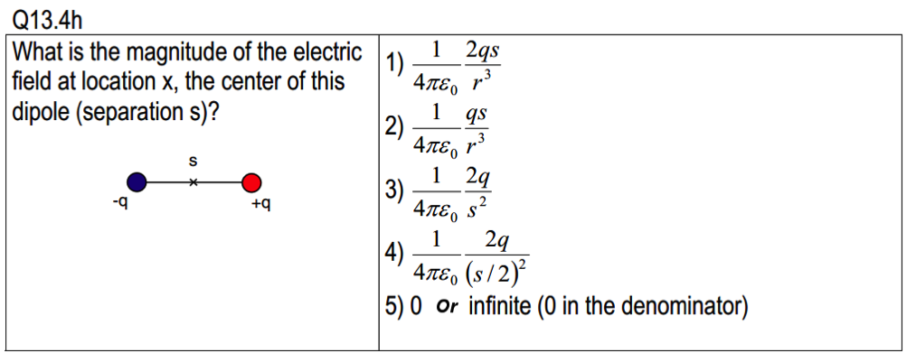
Clicker 5-3

Slide 4
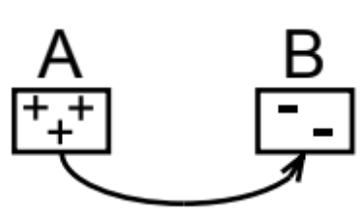
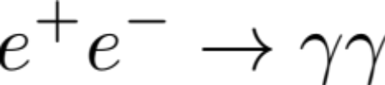
Chapter 15: Electric Field and Matter
Net Charge and Conservation of Charge
Matter: Basic building blocks of matter are made out of + and – and 0 charge. Matter is made out out + and – bits of matter. Net charge of matter can be +, - charged.
Conservation of Charges
Net charge of a system:
Eg. sys, +1 charge
Can have bits of charge move from A to B, but net charge will still be +1
Can also have cancelation process:
Net charge = 0
Net charge = 0
In nature, net charge of an isolated system is conserved.
Total charge of the universe is conserved.

Slide 5
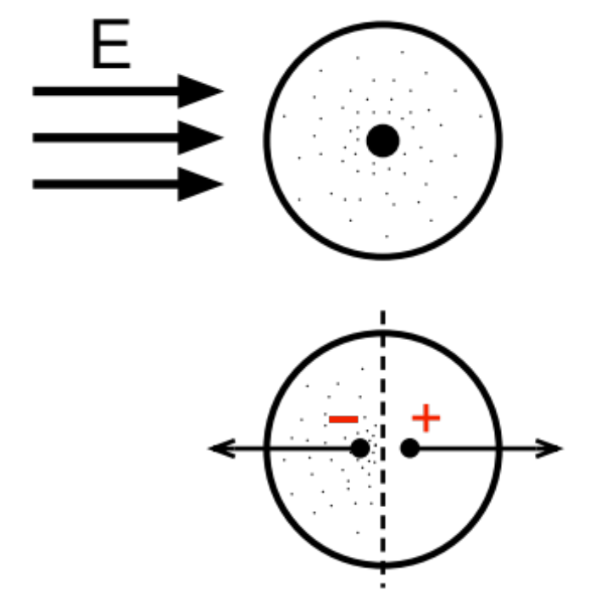

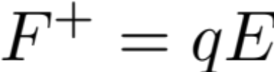

Insulator
insulators
conductors
Matter medium
induced dipole:
insulator: electrons are bound to the atom “no free electrons”
Induced dipole
With dipole moment:
Atom is polarized

Slide 6
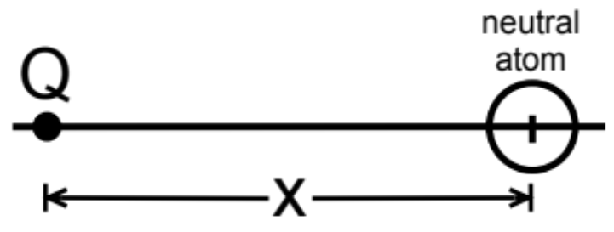
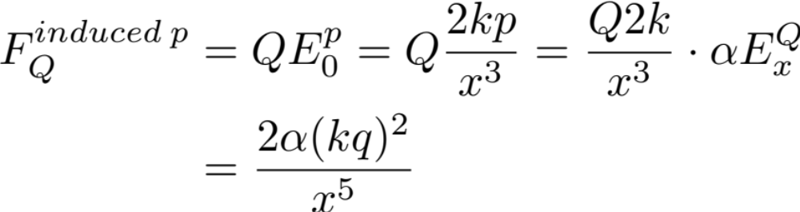
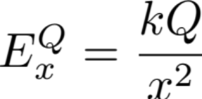
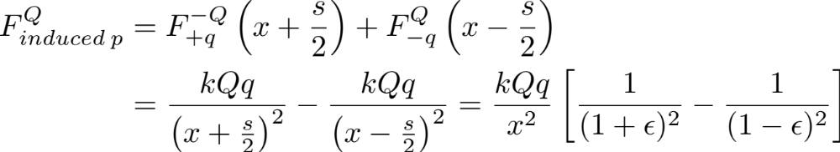
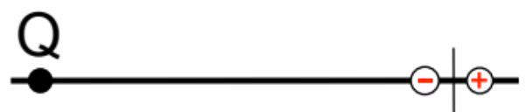
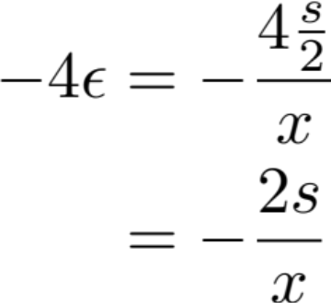
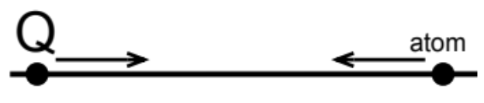
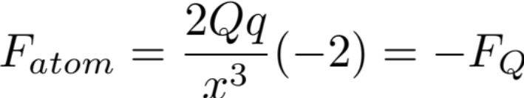
Force between Q (positive) and neutral atom
If Q < 0, there is still an attraction force

Slide 7
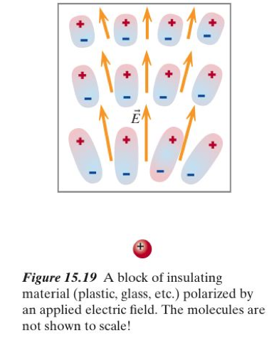
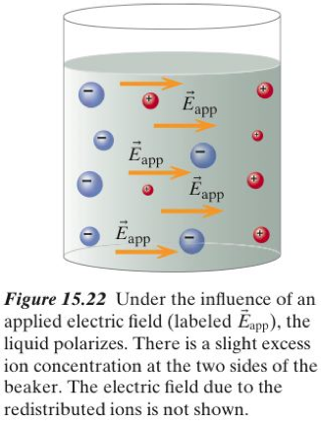
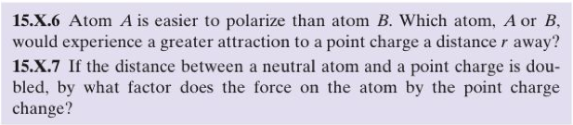
Microscopic view of insulating medium

Slide 8
