Slide 1
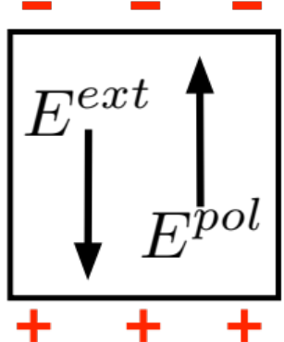

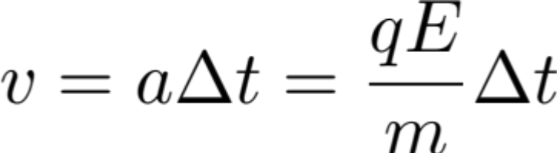
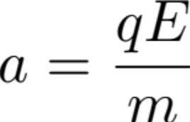
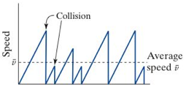
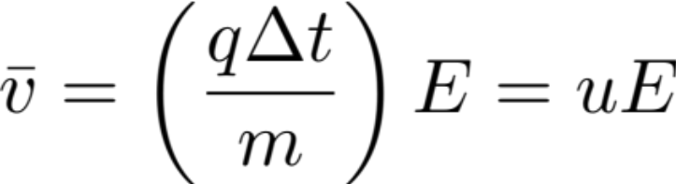
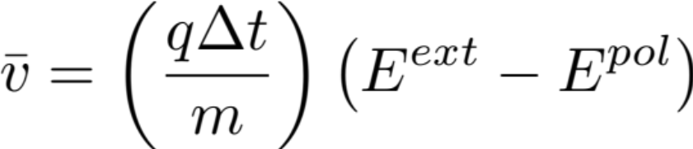


Lecture 6
Insulator
Conductor
E interactions matter
Ionized Solution
Metal
Mobile Electrons
Initial Drift Velocity:
Collision: Δt
electron mobility
Intermediate:
Eventually

Slide 2
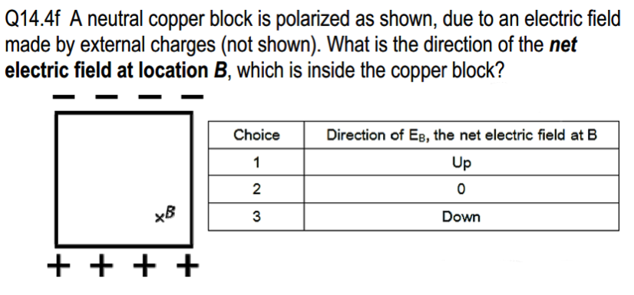

Slide 3
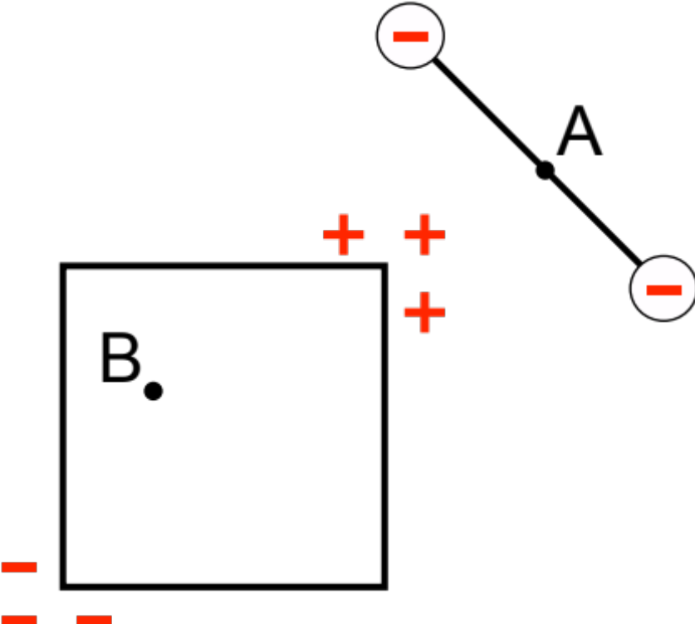
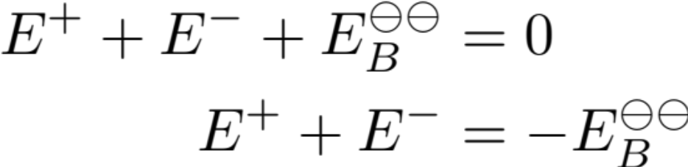
Verify Following Answer:
A. E at B due to positive surface charge
B. E at B due to all charges
Resultant field at B = 0
C. E at B due to all surface charges
At B:
D. E_{A} due to all charges, due to all surface charges
Both lead to:
+
=

Slide 4
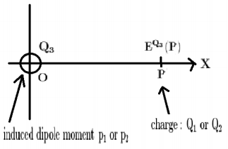
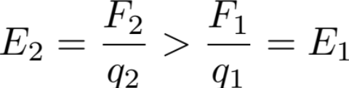


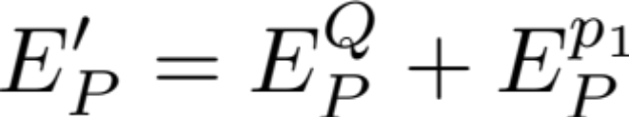
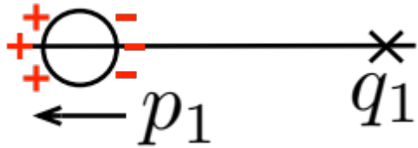
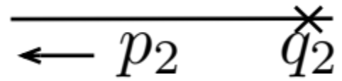
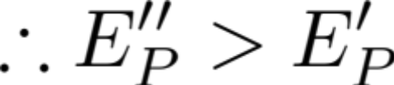
Example HW problem
Example: let Q < 0
For a conducting sphere with
charge Q on it...
Place positive q₁ at P, get F₁
Place positive q₂ at P get F₂
If shows that then
Reasoning:
q₁ leads to E₀^{q1} → p₁

Slide 5
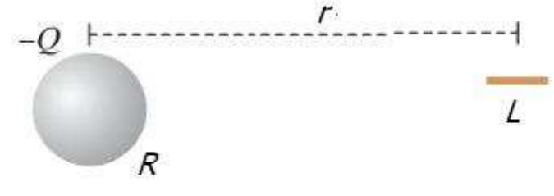
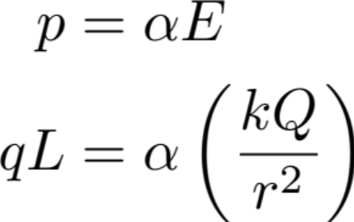
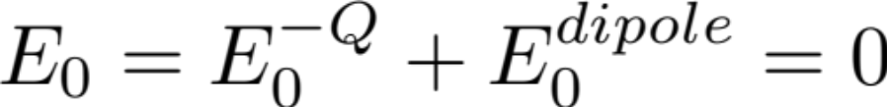
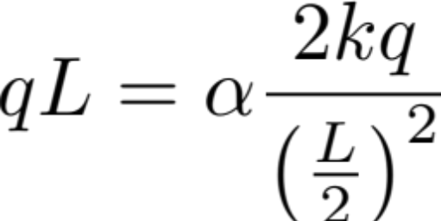
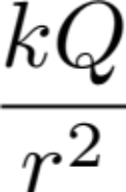
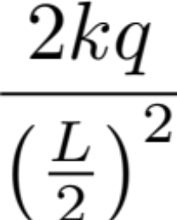
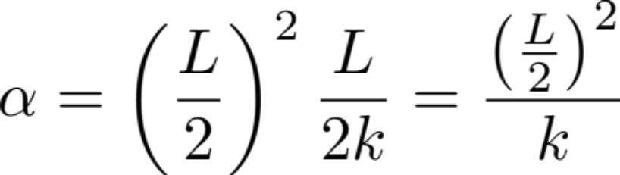
Example Polarizability
Find q, α
At midpoint of the pipe:

