Slide 1
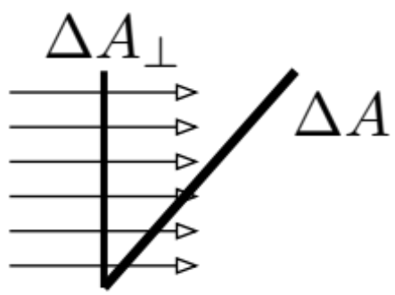

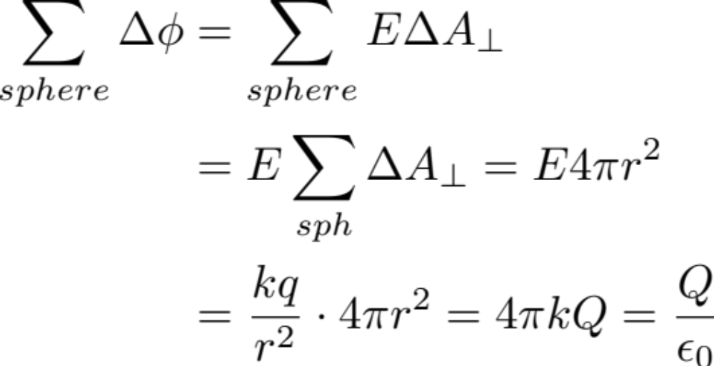
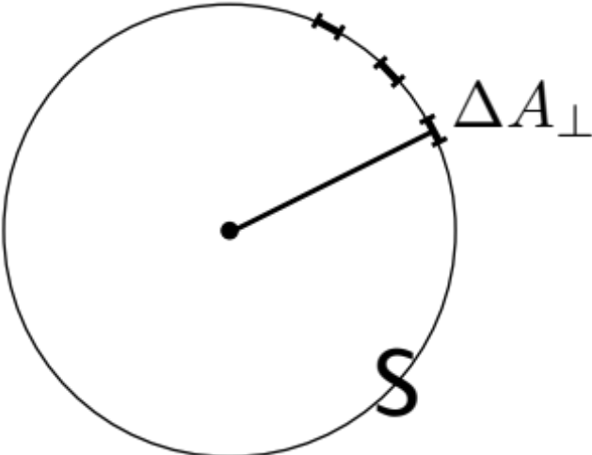
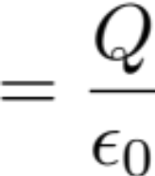
Lecture 11
From coulomb field of a point charge to Gauss Law
We first define Electric Flux:
Consider E-lines hitting an area ΔA.
The electric flux through ΔA is defined by:
E-field
lines
For a point charge Q, the total electric flux hitting the spheres surface with radius r is given by:
In other words: Total Flux emitted by he point charge

Slide 2

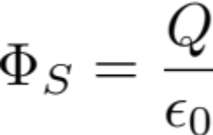
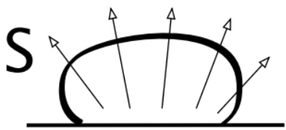
General Statement of Gauss Law
Define Gaussian surface S to be the surface which enclosed the charge then flux emitted through S equates to: .
Turns out, S can be any arbitrary shape, Q can be any charge distribution within S.
We have .
Porcupine-needle analogy:
by counting the needles, one can determine
the size of the porcupine.

Slide 3
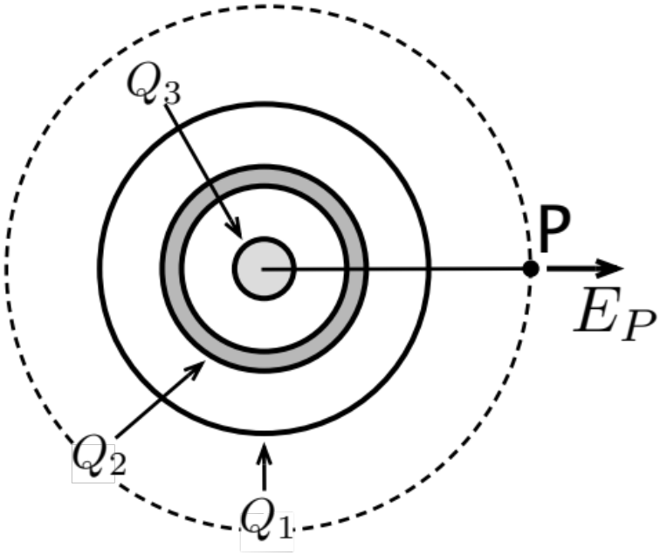
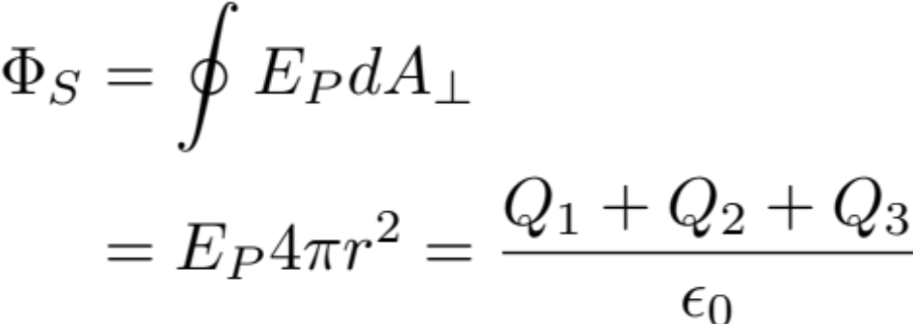
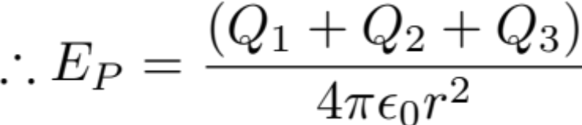
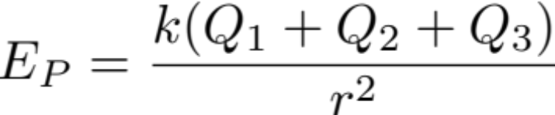
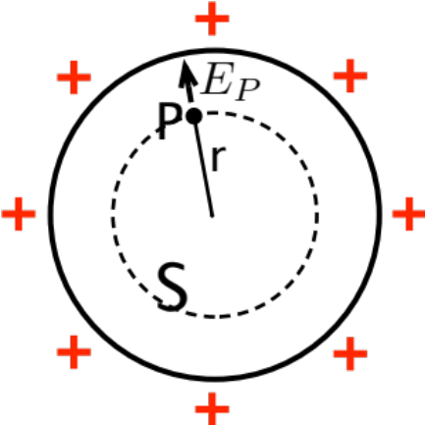


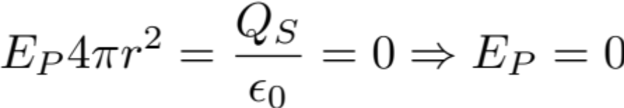
Field due to charges which have a spherical symmetry.
Find E_{P}
So far as it is spherically symmetric:
Proof:
through P draw Gaussian surface S

Slide 4
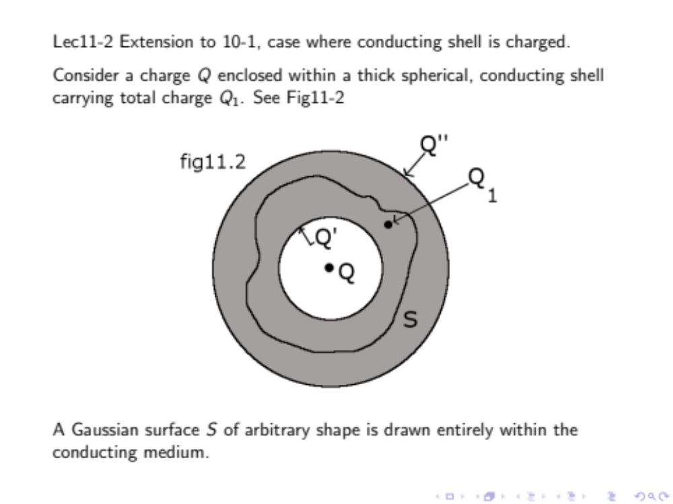

Slide 5
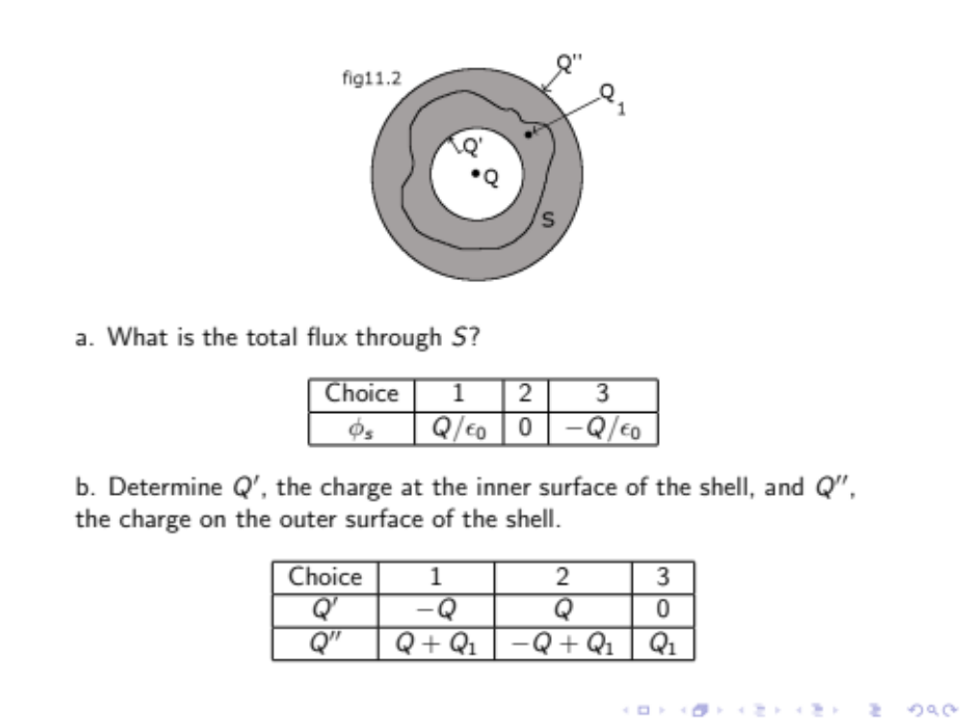
Clicker 11-1

Slide 6
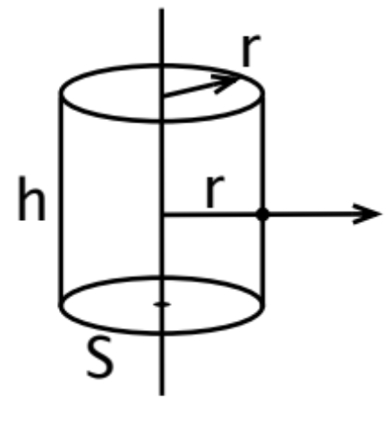
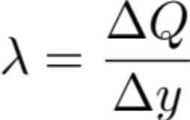
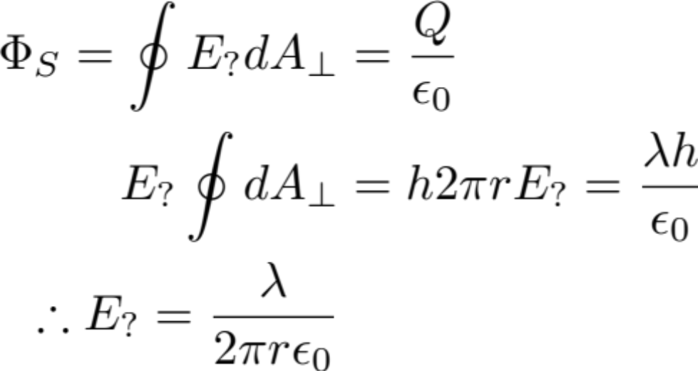
Cylindrical Symmetry
Given: Long uniformly charged rod
P
Find: Field at P
Gaussian surface – cylinder through P
E? radially outwards

Slide 7
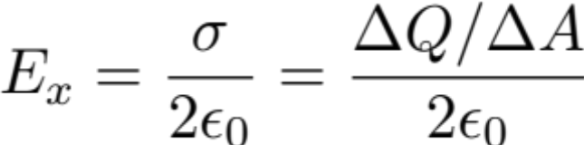
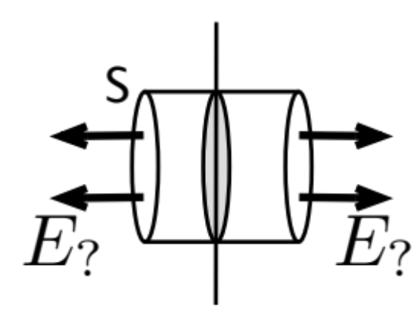
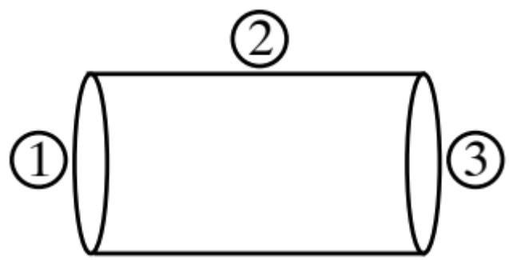
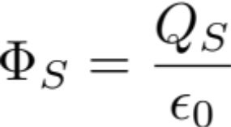
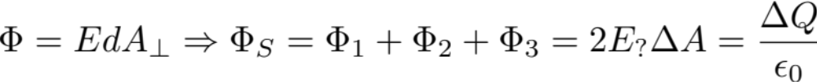


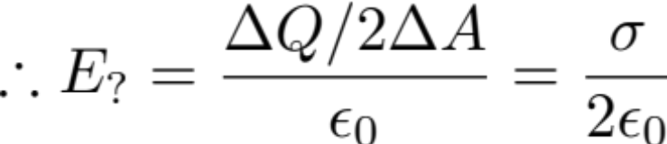
Plane symmetry: one plane
From analytic integration, results we have
ΔQ: in the shaded area
ΔA: Ends of the cylinder

Slide 8
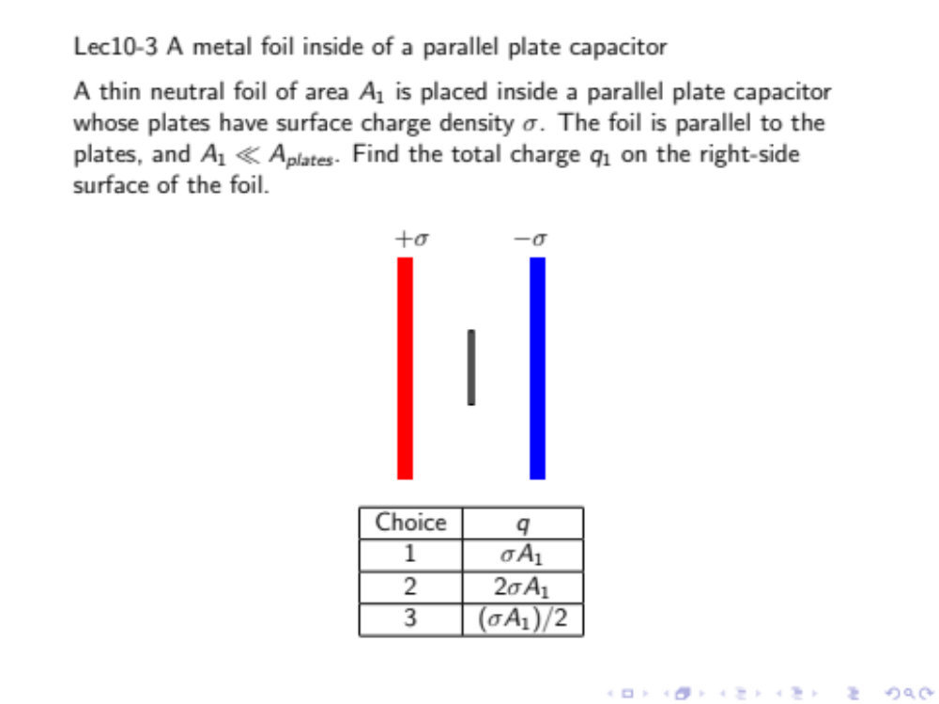
Clicker 10-3

