Slide 1
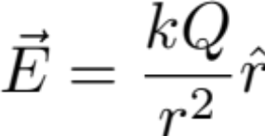

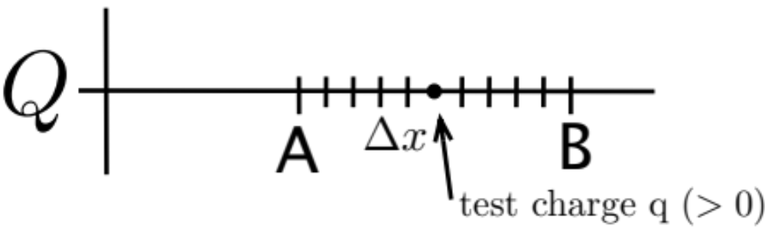


Lecture 15
ΔU and ΔV due to a point charge
Consider going from A to B
Iterative Reasoning
Going downhill.

Slide 2
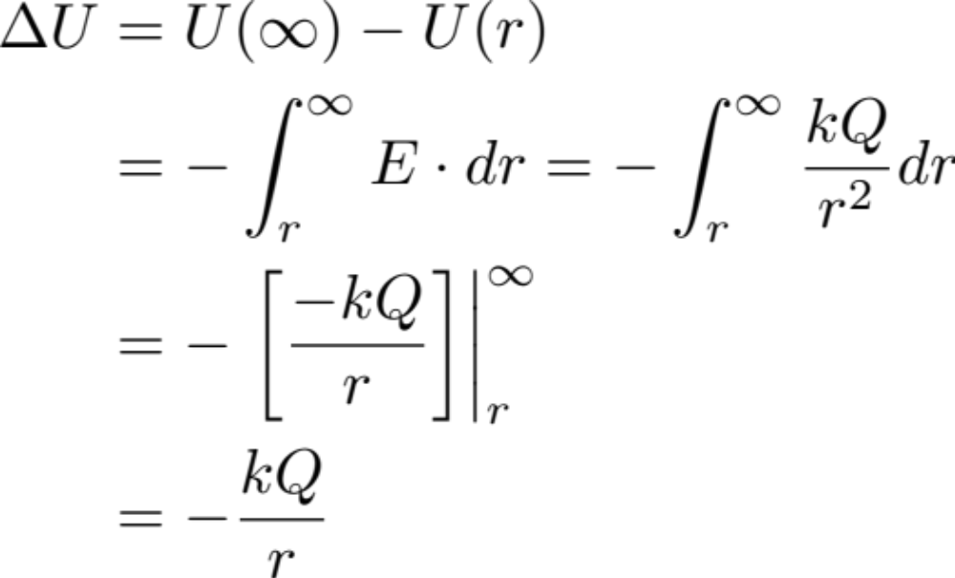
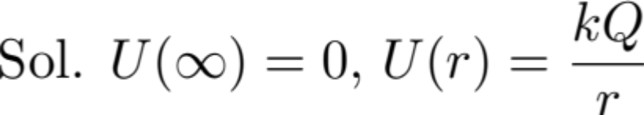
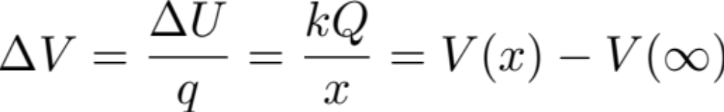
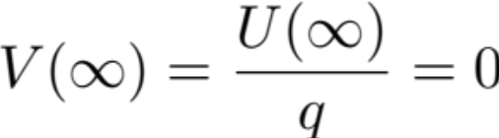
ΔU and ΔV due to a point charge continued...
Math:
here

Slide 3
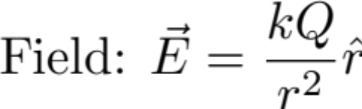
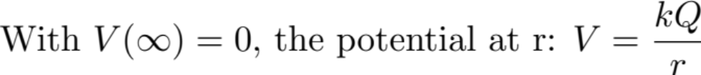
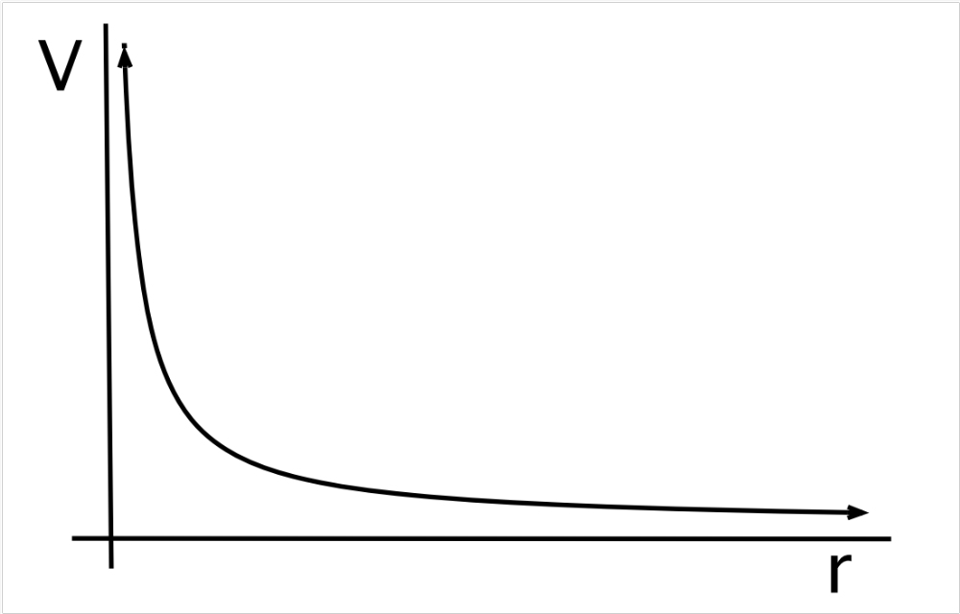
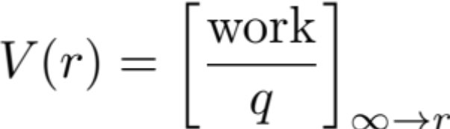
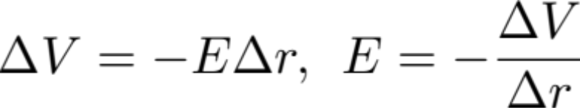
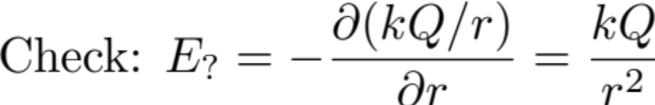
Point Charge Q
Where work from infinity to r is energy required in climbing the potential hill
Q

Slide 4
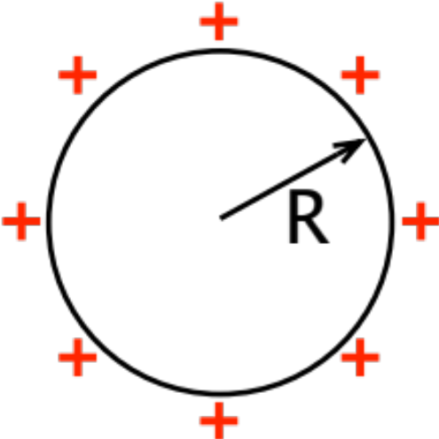

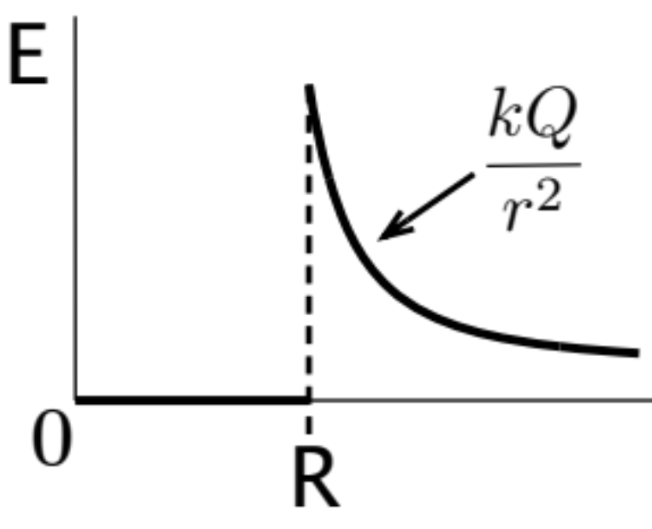
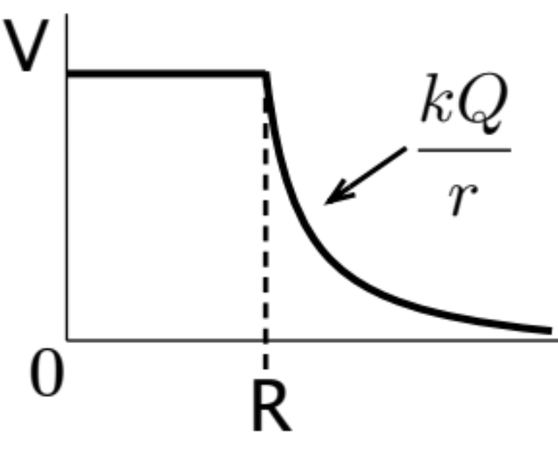
V(r) for a uniformly charged plastic shell

Slide 5
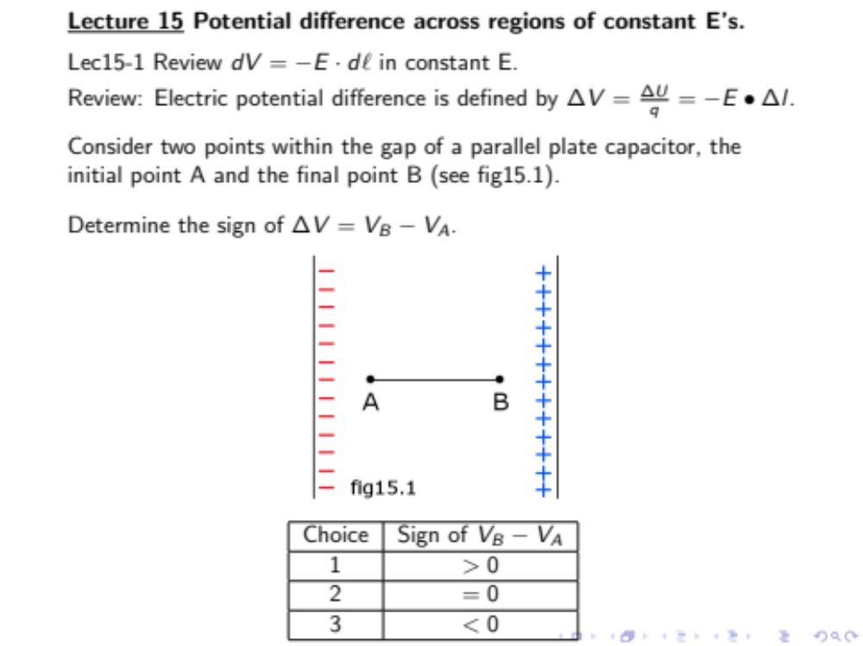
Fig(clicker) 15.1

Slide 6
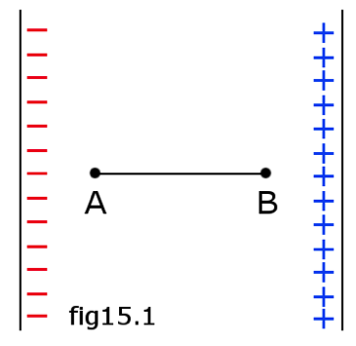
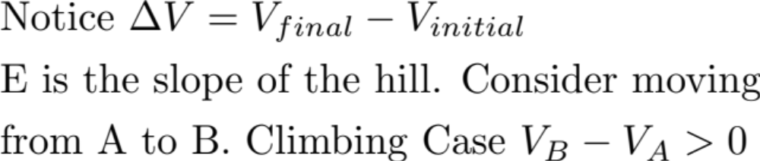
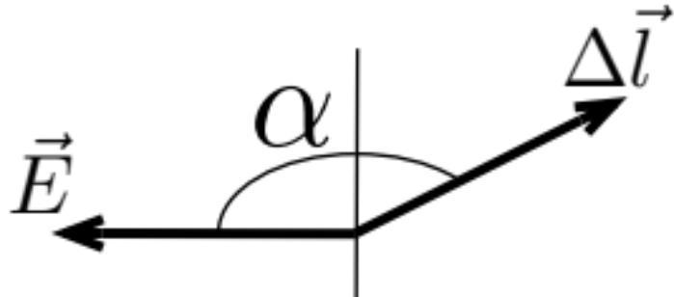
Fig(clicker) 15.1
180°
General Case:

Slide 7
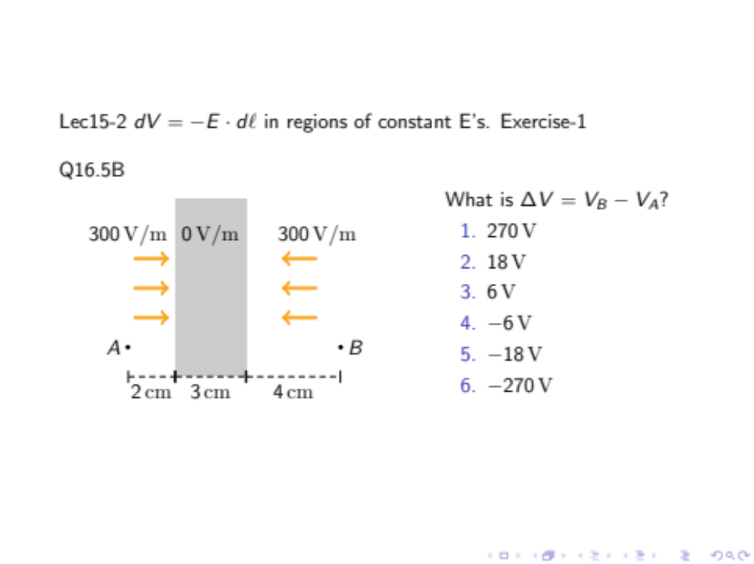
Fig(clicker) 15.2

Slide 8
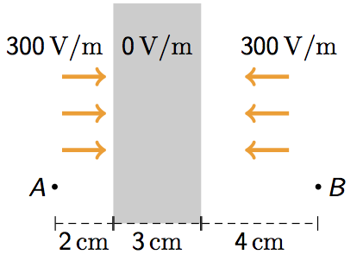






Fig(clicker) 15.2
Region 1
-6
Region 2
0
Region 3
+12
+6

Slide 9
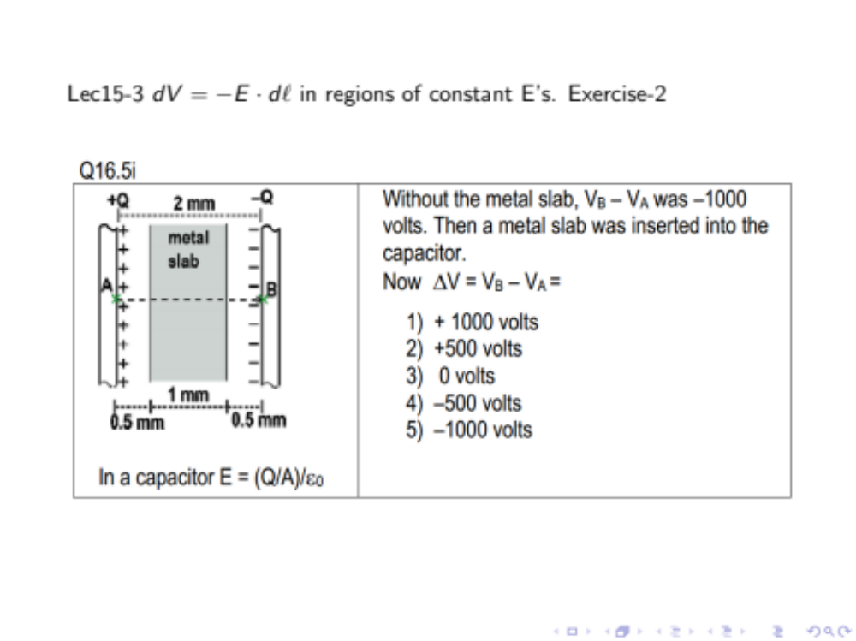
Fig(clicker) 15.3

Slide 10
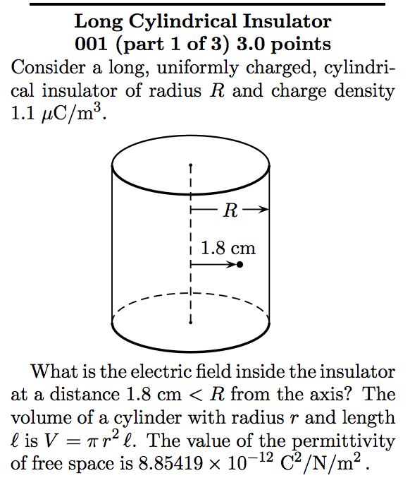
Ch17. Hw2:001-003

Slide 11
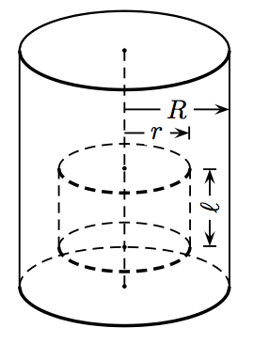
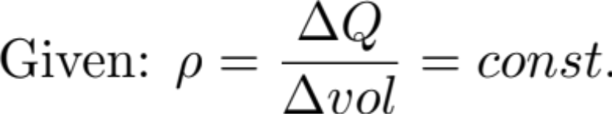
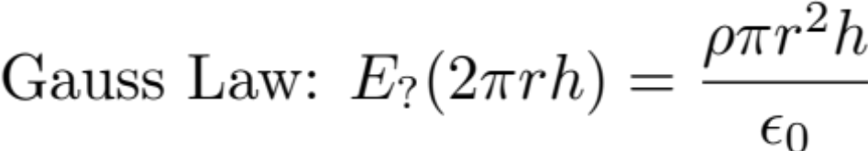
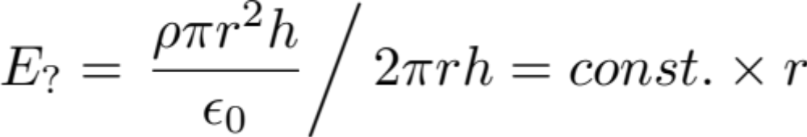
Ch17. Hw2:001-003 continued...
Clicker 17-h2:1-3
What is the sign of V(R) – v(r)?
1 | +
2 | 0
3 | -

Slide 12
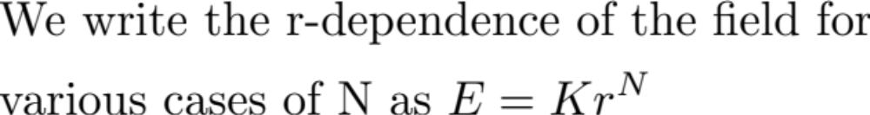
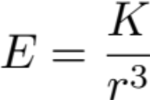
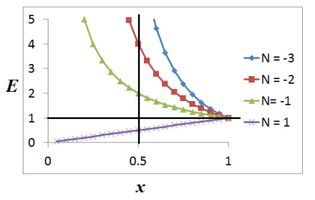





N-dependence of ΔV
For dipole:
point charge:
long rod:
solid rod:
The curves of E vs. x for different N’s are shown in the figure. Notice at r = 1, E = k, independent of N. In going from N = -3 to N = -1, the peak at x = 0 becomes less and less pronounced. At N = +1, the peak turns into a valley.
Lesson: The shape of E vs. x curve is sensitive to the power of N.

Slide 13
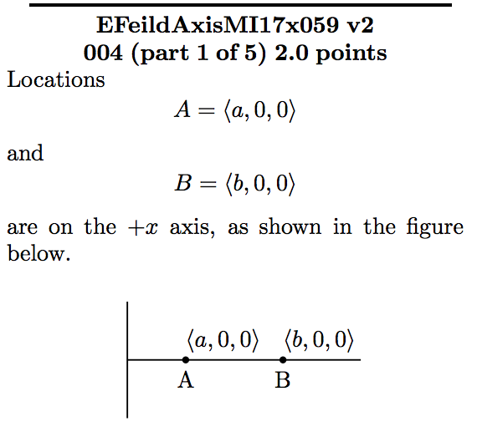
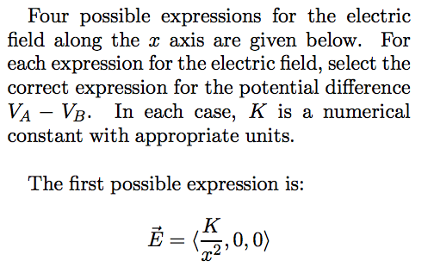
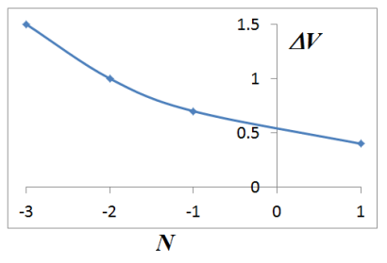
How does ΔV very with N?
Choice: | N increases
1. | ΔV increases monotonically
2. | ΔV = constant
3. | ΔV decreases monotonically
4. | ΔV fluctuates as N increases

