Slide 1
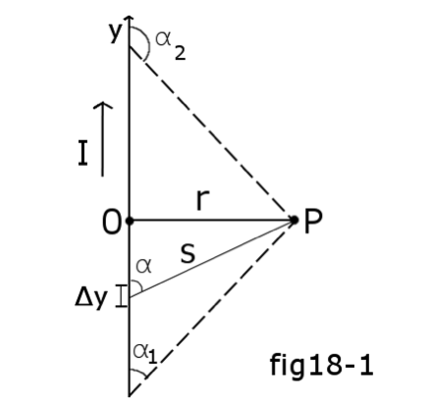


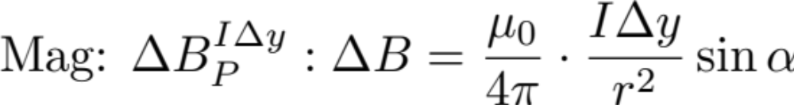
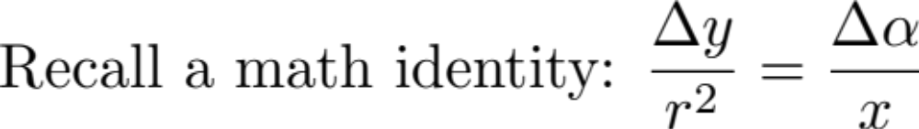
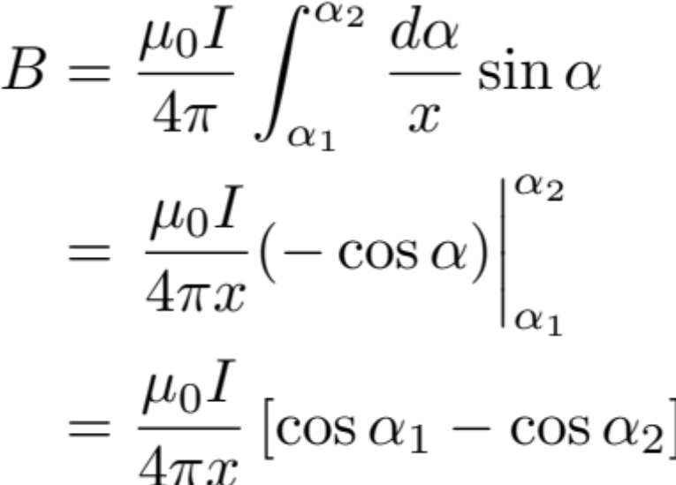
Lecture 19
Biot-Savart Law Application II
A long wire. Find B at P

Slide 2
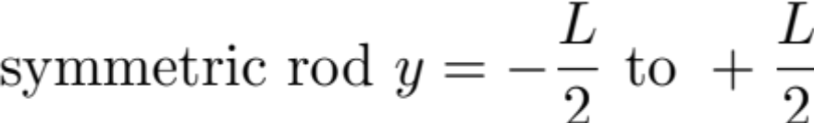
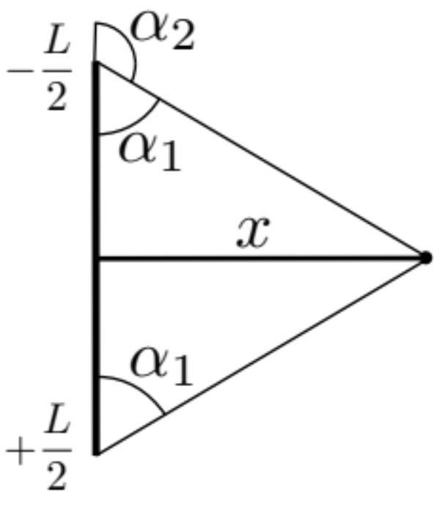
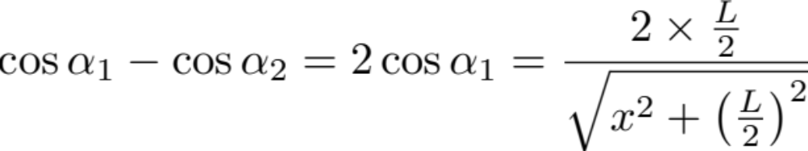
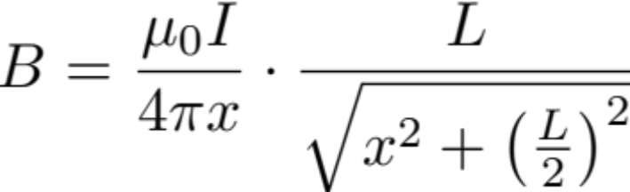
The textbook case –
(see pg 721 in textbook last equation)

Slide 3
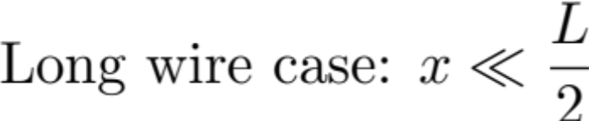
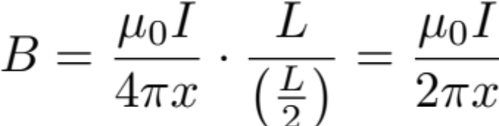

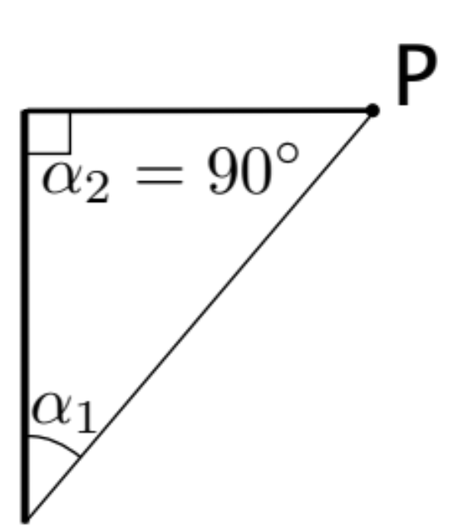
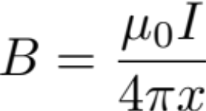

Slide 4


3 RHRs

Slide 5
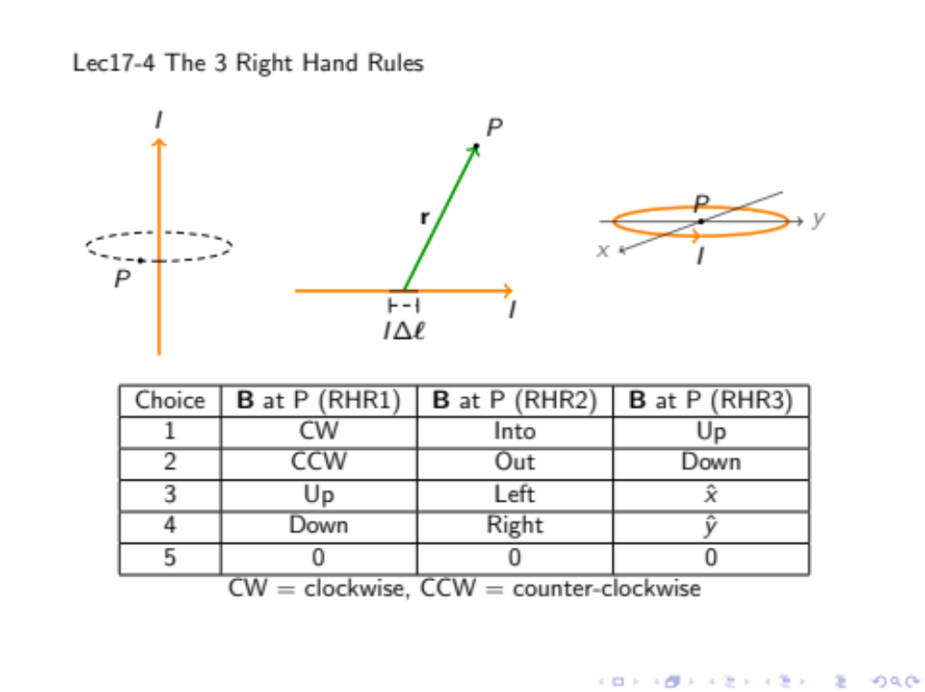
Fig(clicker) 17-4
Choice | B at P (RHR1) | B at P (RHR2) | B at P (RHR3)
1 | CW | Out | Up
2 | CCW | Out | Up
3 | CCW | Out | Down
4 | CCW | Into | Up
View from top

Slide 6
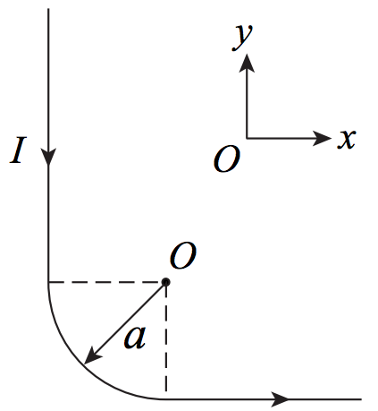

Comments on Ch18-02 003-004
Curved wire segment
Superposition Principal
“A”
Check direction of B contributed by each segment is in the same direction, so vectors are reduced to simple addition.
“B”
“C”

Slide 7
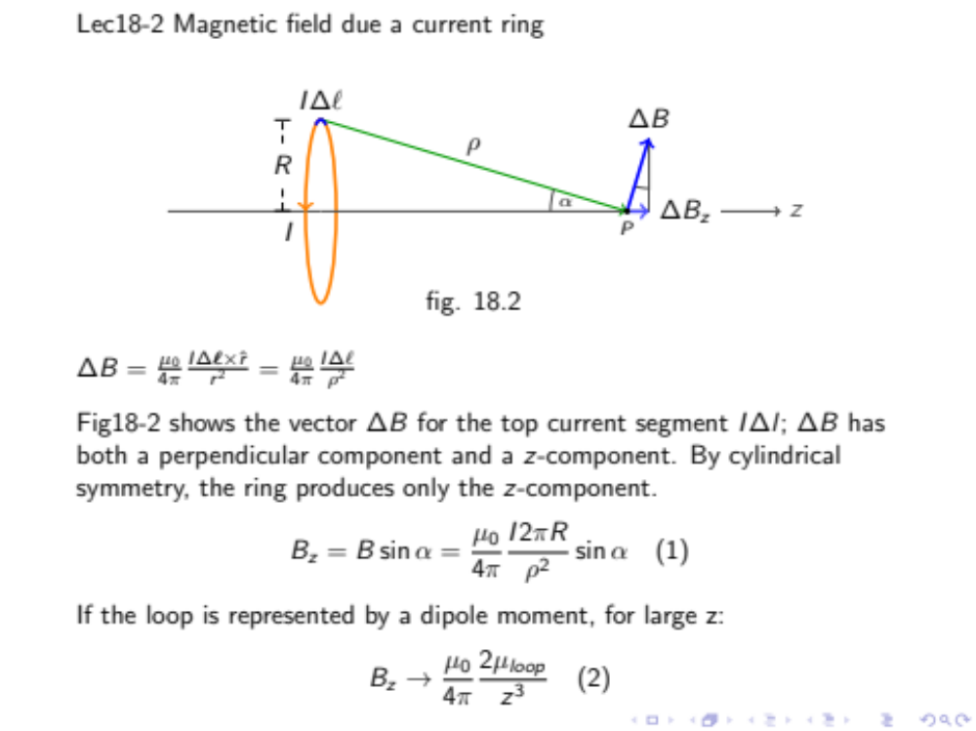

Slide 8
