Slide 1
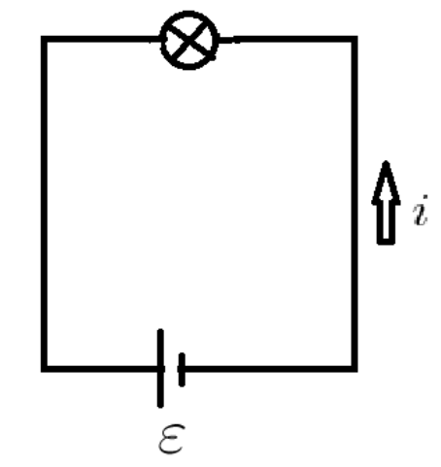
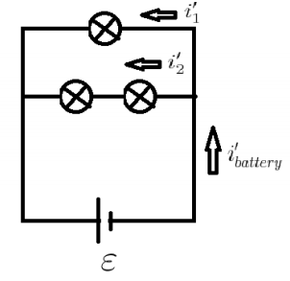

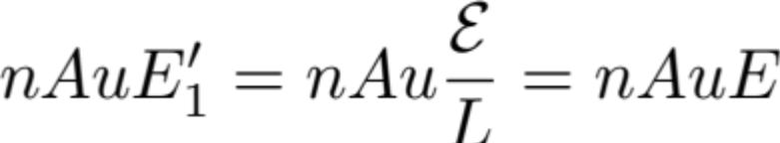
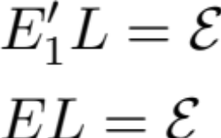

Lecture 24
Example Problem:

Slide 2

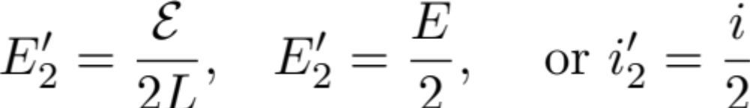
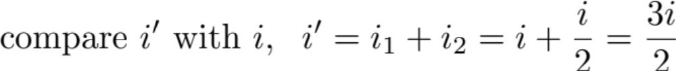

Slide 3
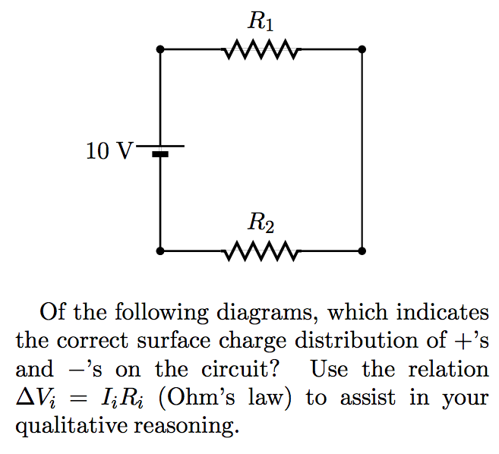
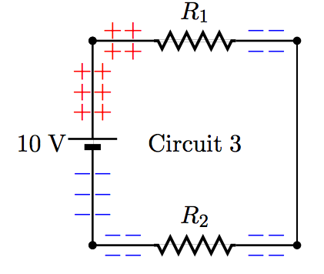
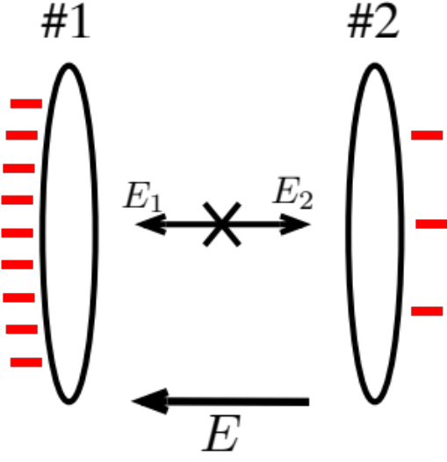
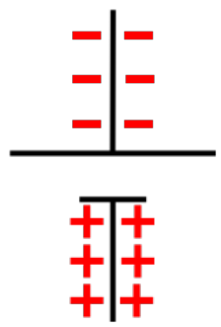
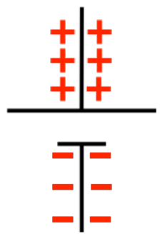
Example Problem 2:
Change of local surface charge density leads to the local E within the wire.
Inspection on wrong choices:
wrong sign, should be:

Slide 4

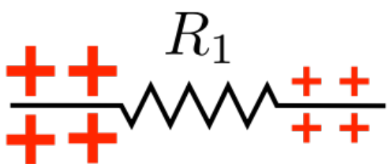

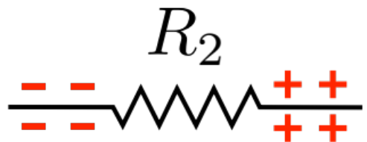

Inspection on wrong choices continued...
Picture has smaller charge density change across R₁. So ΔV₁ < ΔV₂
This is contradictory to the given, R₁ > R₂

Slide 5
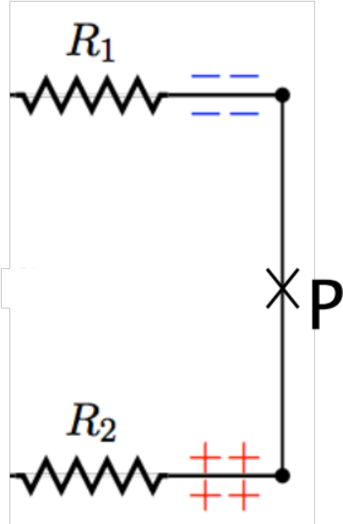
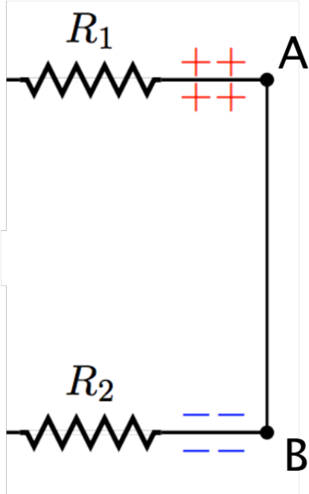
A
Current flow should be clockwise,
i.e. from A to B, or at P, I is downward or E_{P} is downward
The surface charge leads to E_{P} upward which is inconsistent with CW current flows.
B
There is a potential difference between A and B.
This is inconsistent with set up where V_{A} – V_{B} = 0.

Slide 6
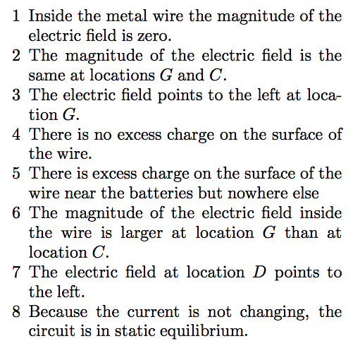
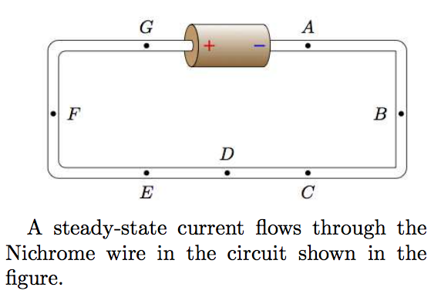
Example Problem 3: Which of the following statements are true?
We discuss the first 4 statements here:
Incorrect. In the steady flow, i = const., E = const., but E is not zero.
At G and at C, the cross section is the same :
Correct by inspection
Incorrect. We need excess charges to generate E, in turn the excess in the wire.

Slide 7
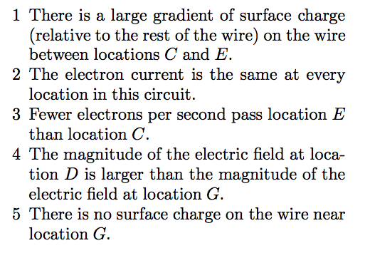
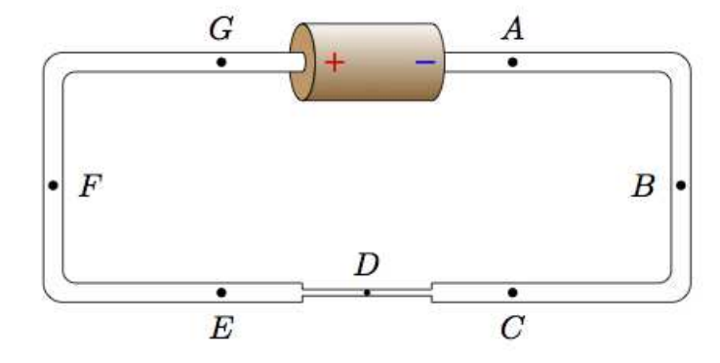
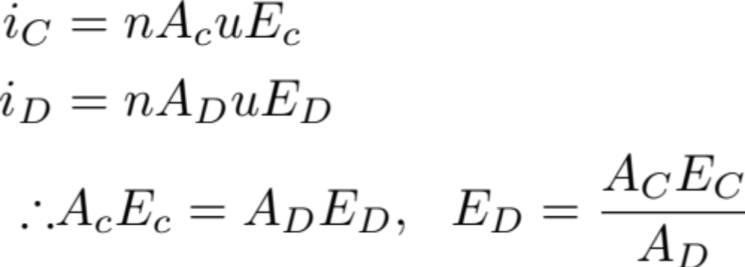
Typical Homework Problem 4: Which of the following statements are true?
We discuss the first 2 statements:
Correct. Here i_{e} = i_{O} = i_{c} (steady flow within 1 loop)
  Since ED is much bigger, the surface charge gradient must be larger also.
Yes. There is a steady current flow. The # of electrons pass through each point must be the same to avoid the pile up.

Slide 8



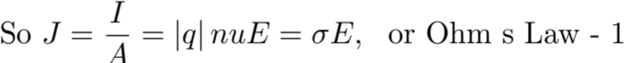
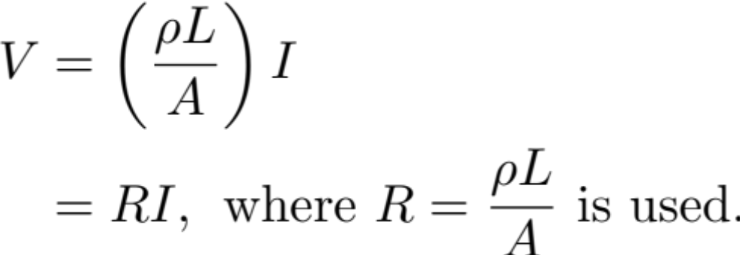
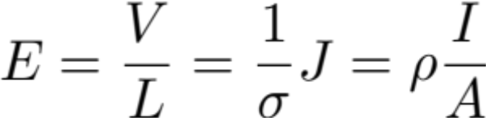
Preview of Chapter 20:
Ohm’s laws: conventional “macroscopic” ohm’s law are:
Ohm’s Law-1:
Ohm’s Law-2:
How are the related to ?
Ohm’s Law-2 follows
or

