Slide 1
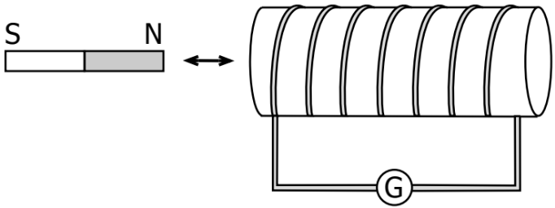
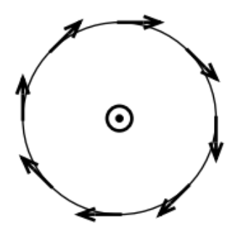
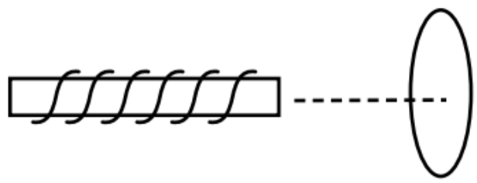

Lecture 29 – Faradays Law and Lenz Rule
Demo:
Levitation of a cubic magnet
Jumping Ring
Falling magnet in a metal tube
Single faraday’s law demo
side view:

Slide 2
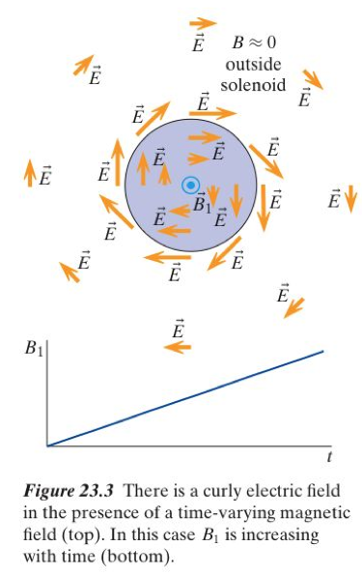
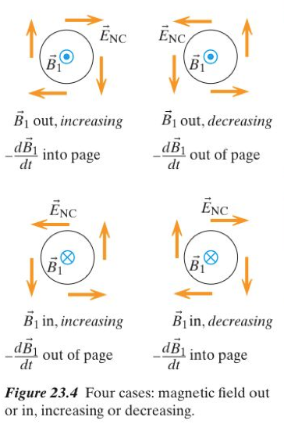

Slide 3
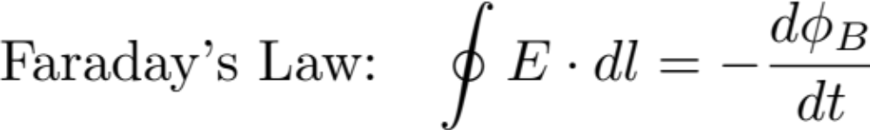
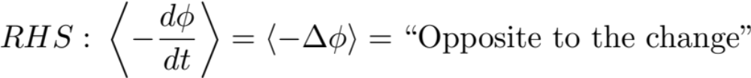

Lenz Law: Current loop has magnetic inertia.
It has the tendency to maintain its flux state.
Initial: 10 lines out
Next: 12 lines out (2 lines in to maintain original 10 lines out status

Slide 4
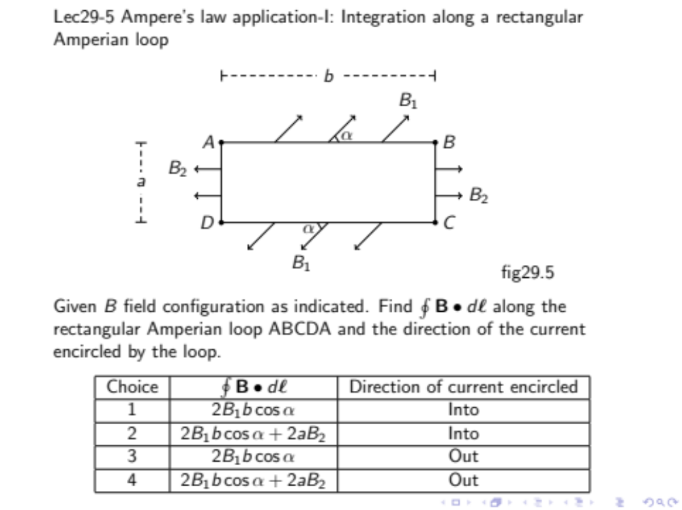

Slide 5
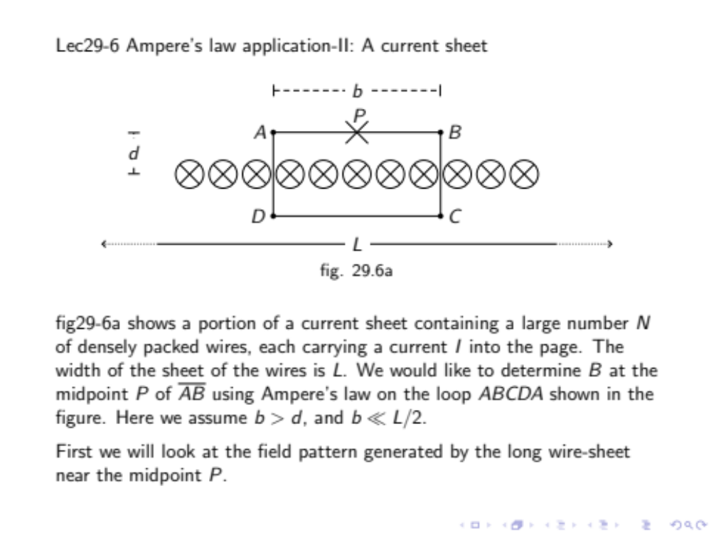

Slide 6
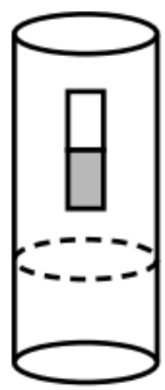
Application: Falling magnet in a metal tube
Demo: The falling magnet moves slowly
Do the current below the magnet
You will do the case where the loop is above the magnet.
The loop has magnetic inertia:
Now: 3 lines ⬇
Next: 5 lines ⬇

Slide 7
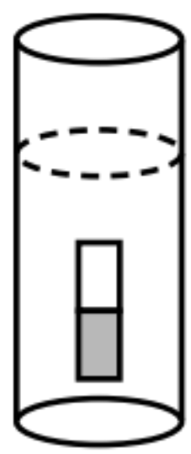

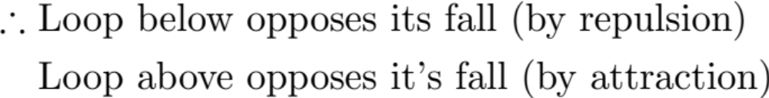
Now for the current loop above the magnet
Now: 3 lines ⬇
Next: 1 lines ⬇
It affects the falling magnet:

Slide 8
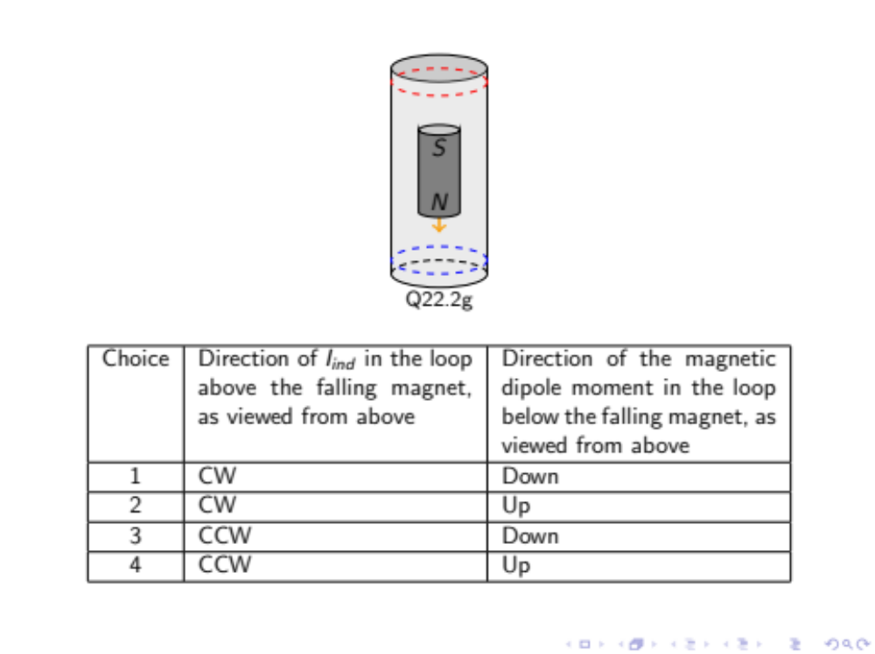

Slide 9

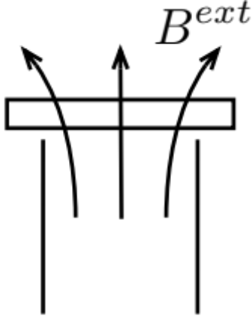
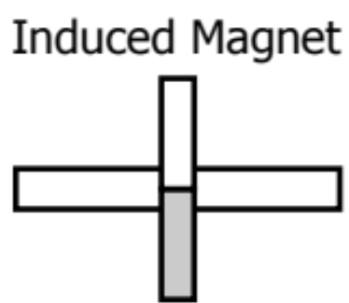
Jumping Ring Demo:
Show current loop as magnetic initial.
After we turn on B of the solenoid, the ring jumps away to maintain net flux state.
Understanding the force affecting the ring:
= stronger lifting force

Slide 10
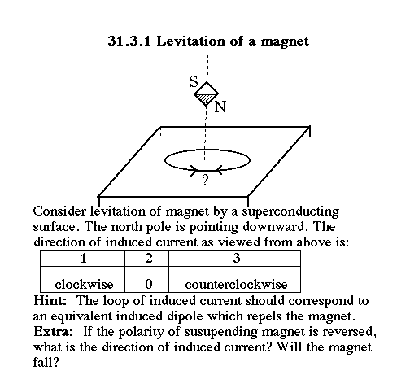

Slide 11
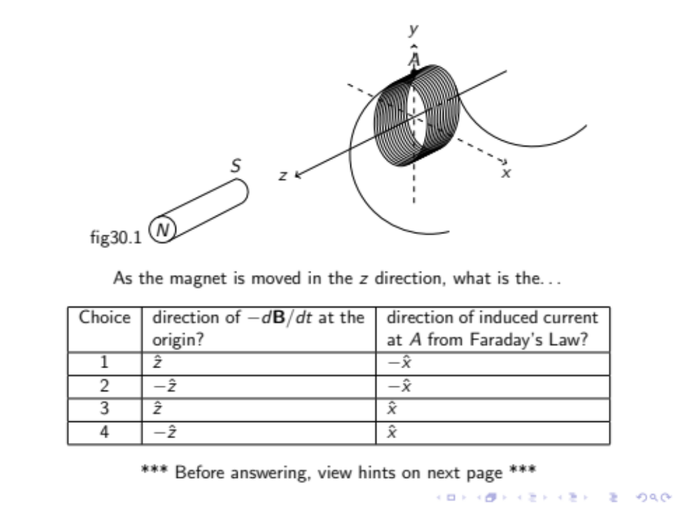

Slide 12
