Slide 1
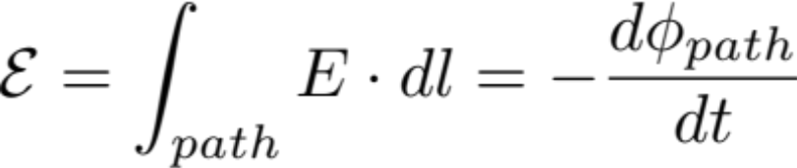
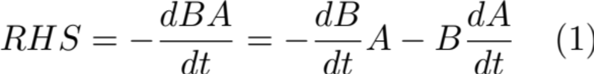
Lecture 30
Motional emf is a special case of Faraday’s Law
General form of Faraday’s Law:
The path is the Faradian loop.

Slide 2

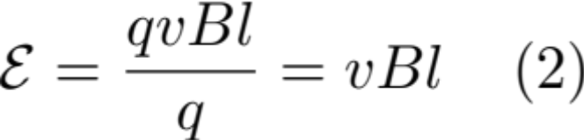
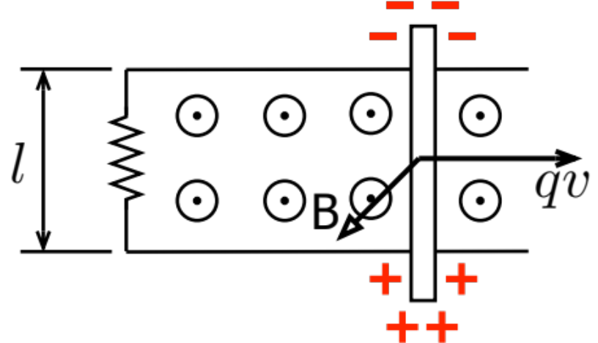
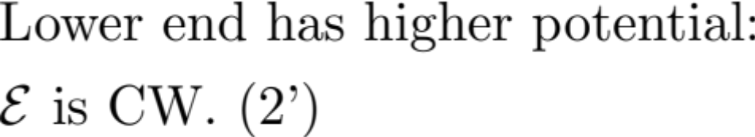
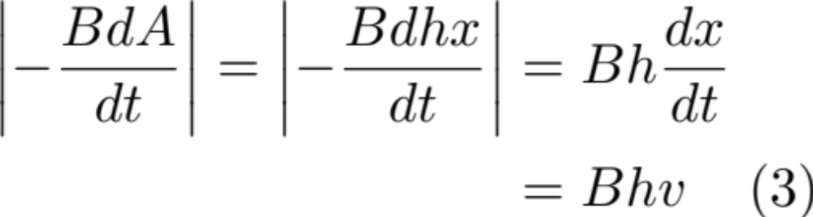
Check: Moving rod along two || railing setup gives:
which can be derived based on Faraday’s Law
From motional emf:

Slide 3
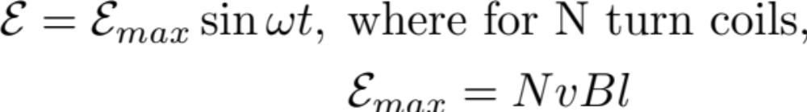
We see (2) and (2’) agree with (3) and (3’). Our motional emf is a spherical case of Faraday’s law.
One can show in the case of current loop from both consideration one finds:

Slide 4
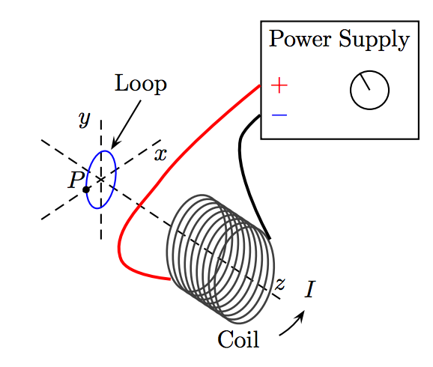


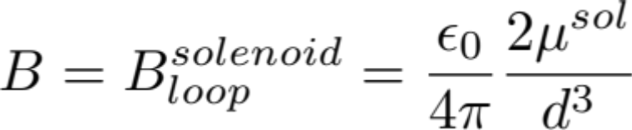

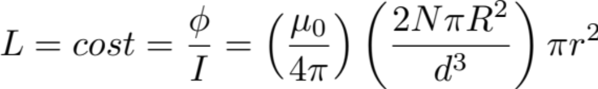

Slide 5

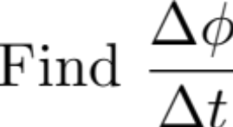
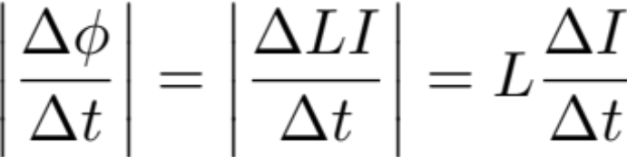
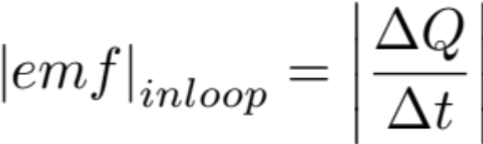
What is E_{in} at P when I = const.?

Slide 6
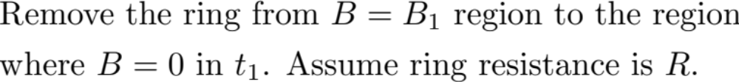
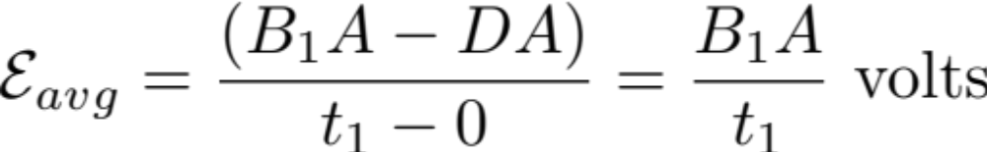
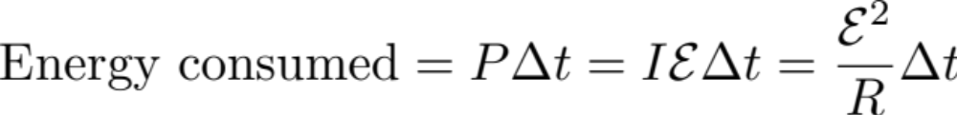
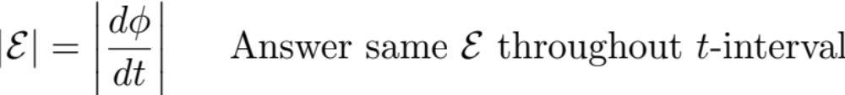
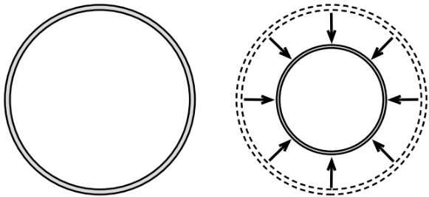
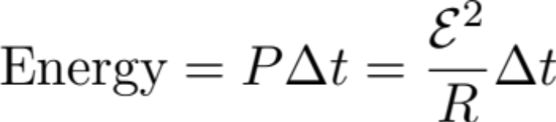
What if the loop is shrinking down too?
shrinking down to 0

Slide 7
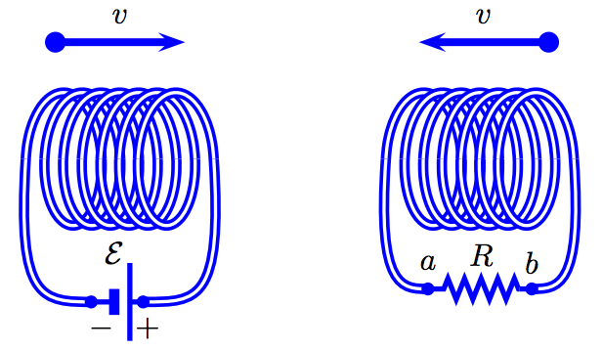
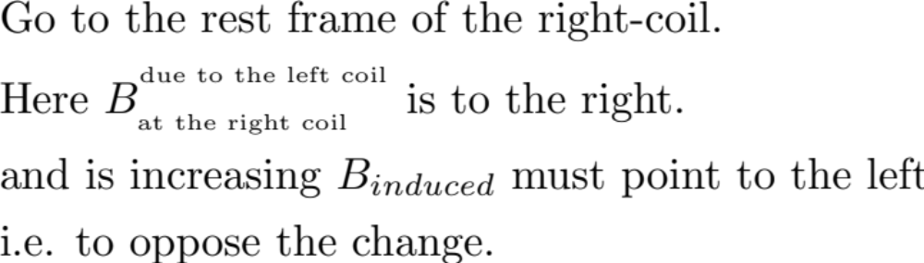
Example Problem:
Determine the direction of the magnetic field in the coil with the battery attached.
Determine the direction of the magnetic field in the coil with the resistor attached
Determine The direction of the induced current in the resistor
Hint:

Slide 8
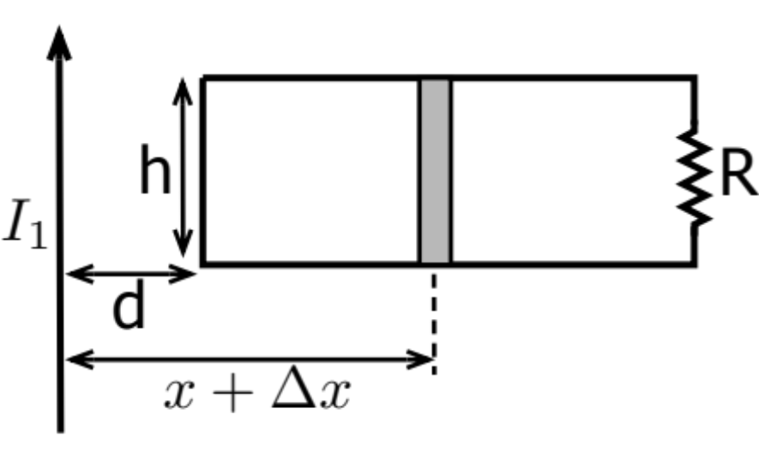
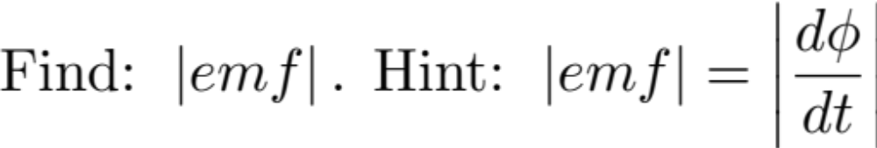
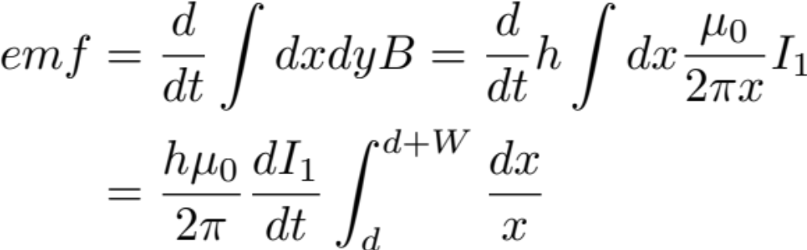
Example Problem:
If I₁ is decreasing, find direction of emf_{ind} in the loop
Choices
1 – CW
2 - CCW

Slide 9
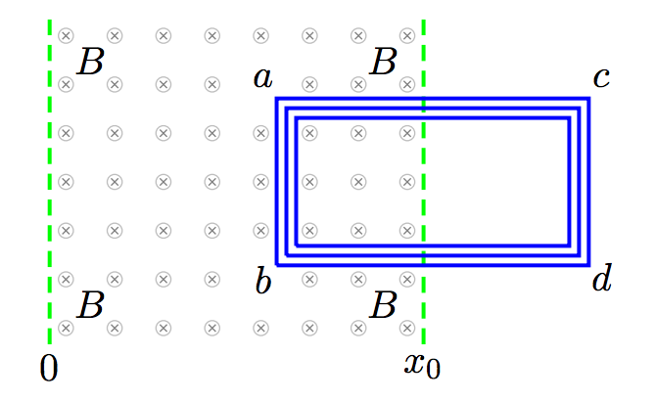

Example Problem
Determine the direction of the force on the segment AB as B is decreasing.
Hint: The force on ab is given by:
First determine the direction of B_{in} (should it be into or out)
The correct response is to keep flux within the loop constant

