Slide 1
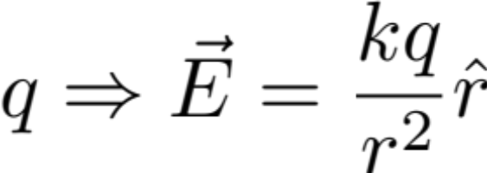
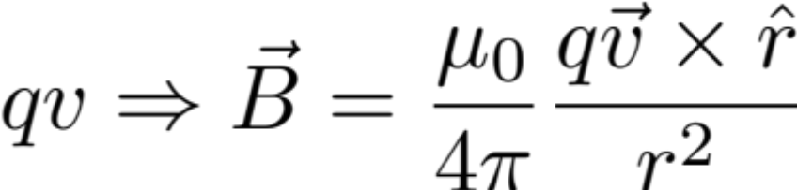
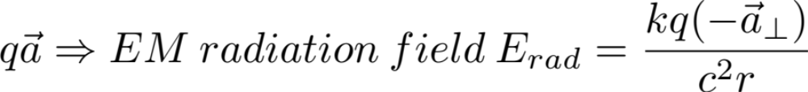
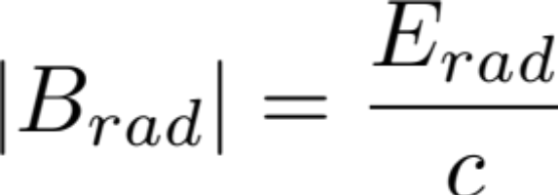
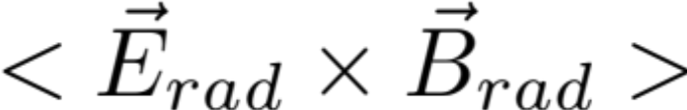
Lecture 36
EM Pulse due to a acceleration of point charge
Fields generated by point charge:
Is direction of travel

Slide 2
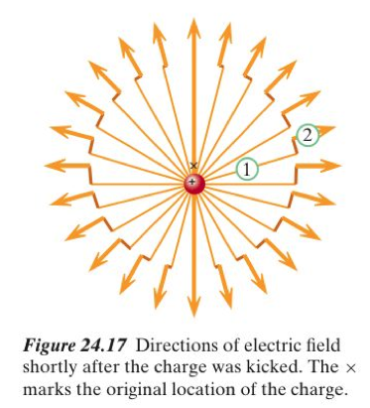
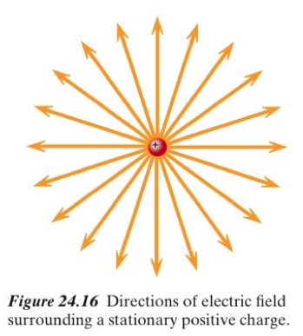
Consider a stationary charge is accelerated (knocked) in a short time. The stationary field pattern is isotropic. A short knock leads to a field pattern with a kink. This kink is traveling radially outward with speed of light.

Slide 3
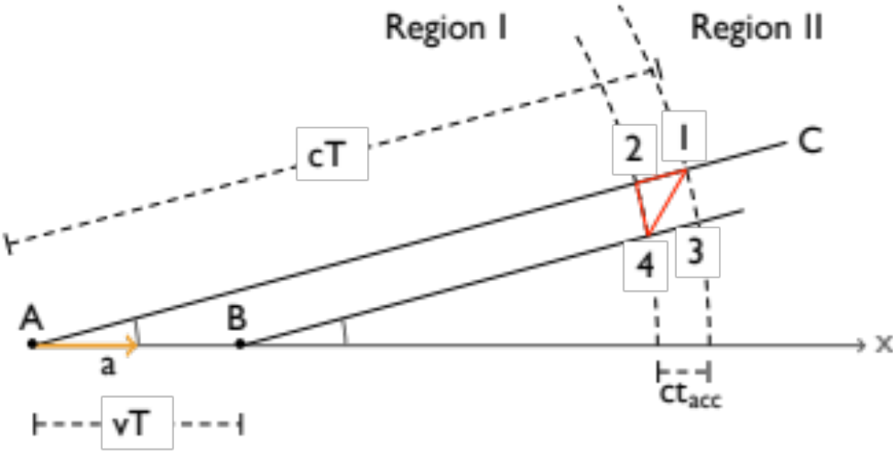
In section 24.11 in the textbook the derivation of field due to acceleration of point charged particle is discussed. We will cover selected features in this derivation.
The figure above illustrates the setup
  A positively charged particle was at rest at location A. At t = 0, it experiences a brief acceleration “a” to the right to arrive at a low speed, v = a t_{acc} after a short time interval acceleration.
  At large time t = T, the light signal from A reaches A’ at distance r and angle θ. AA’ = r = cT
  Along x-axis, A coasts to B along x-axis at AB = vT.
  The light signal from B reaches B’ at angle θ, and at r.
The acceleration zone is bordered by the pair of two circular arcs through the points A’ and B’. The thickness of this radiation zone is ct_{acc}.
A’
B’
D
C
vTsinθ
θ
θ
B
Fig(lec) 36.1

Slide 4
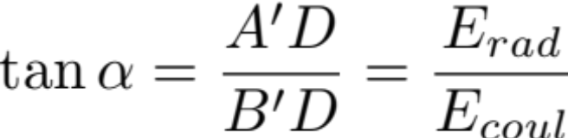

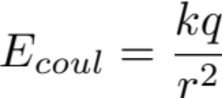
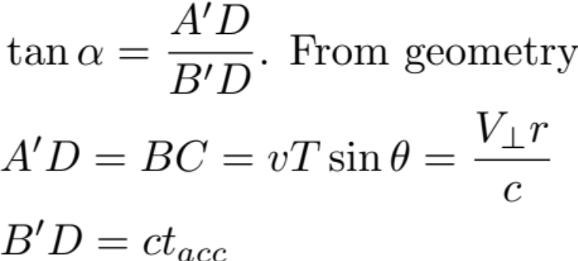
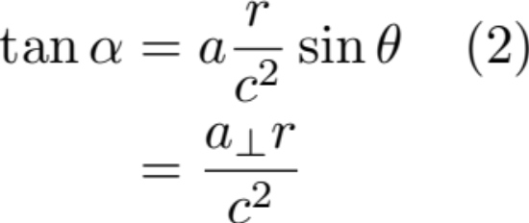
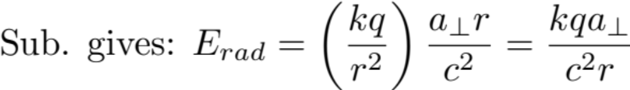
2. From Gauss Law argument, the text shows that in the acceleration zone region there is a similar triangular relationship.
Thus
Here tanα can be obtained from geometry and coulomb field is
known, i.e. . So E_{rad} can be determined.
3. Evaluate the geometric factor.

