Slide 1
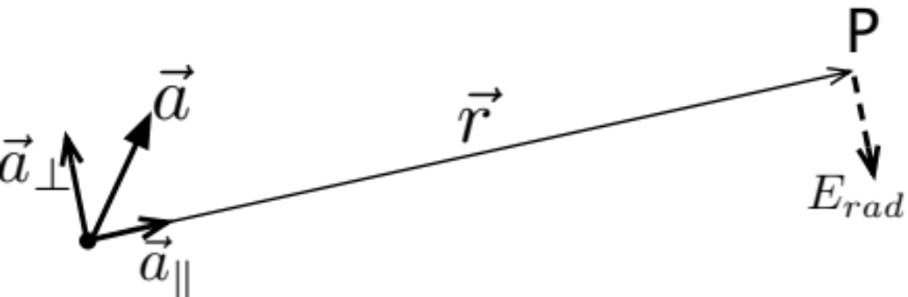
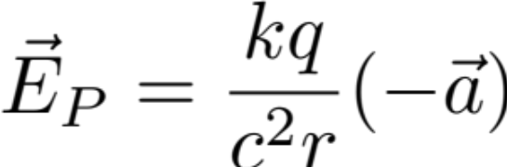
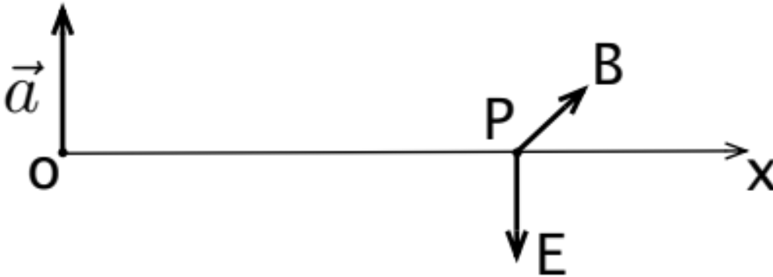
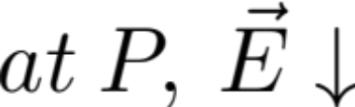
Lecture 37
Application of E-radiation formula due to acceleration of a point charge:
For 1D-plane wave case – simple case: (Assume q > 0)
(Source is a current sheet)
For point charge case, notice only a-perp contributes.
As is convenient, do the vector decompositions as indicated.
At P the direction of E-rad detected is indicated by the dashed vector.

Slide 2
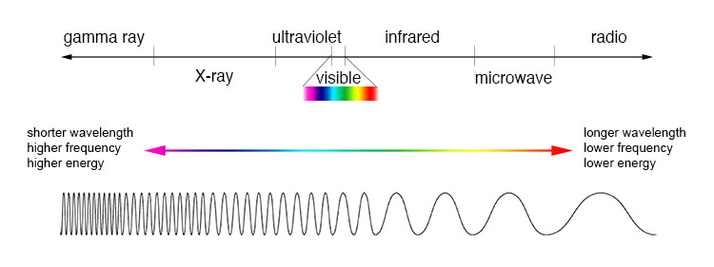

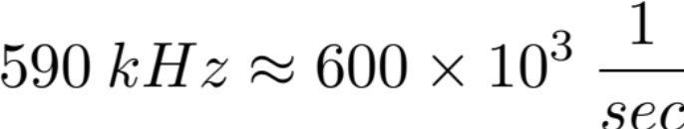
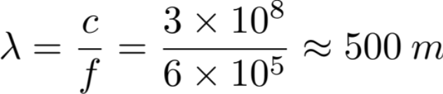
EM Waves
EM waves in a vacuum are specified by one thing:
EM wave spectrum:
increasing
frequency
increasing
wavelength
Radio Station KLBJ
Example of EM waves:
Radio AM | stadium | 10³ m
Microwaves | Bean size | 10² m
Visible Light | Micrometer | 600 nm
X-Ray | Atomi size | 10⁻¹⁰ m

Slide 3
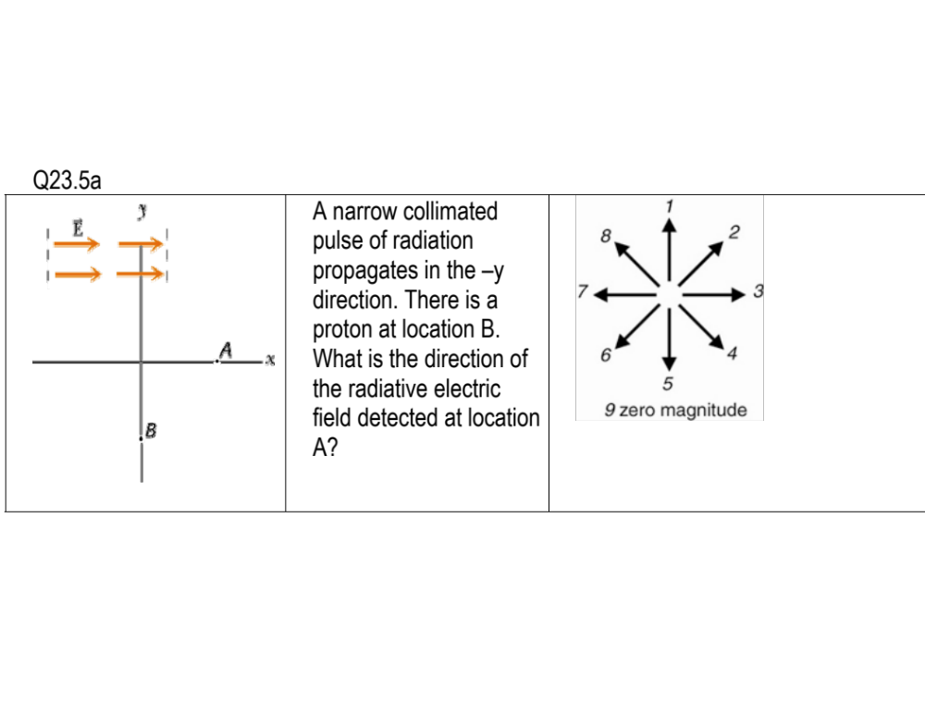

Slide 4
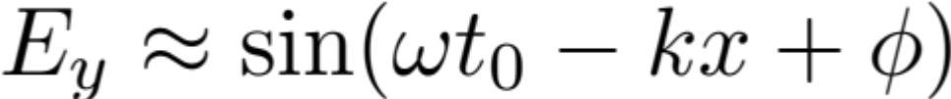
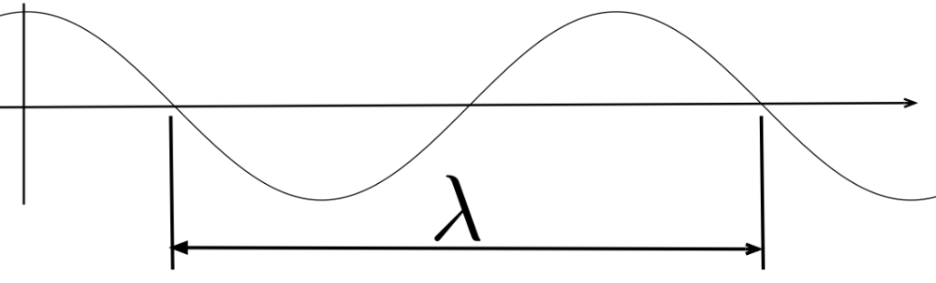
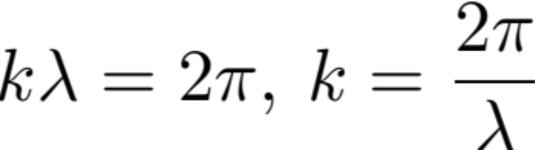
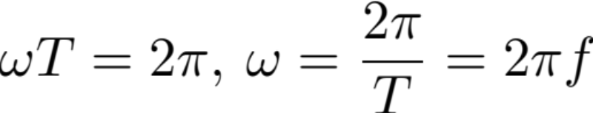
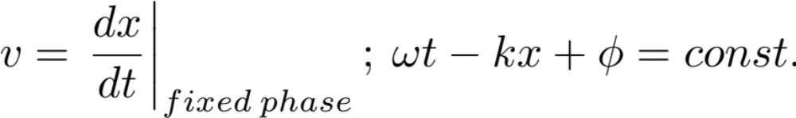

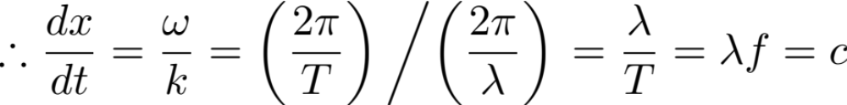
Sinusoidal in x:
λ is a conversion factor from x-scale to angle-scale
Period:
Fix phase: Defines the speed the fixed shape travels

Slide 5

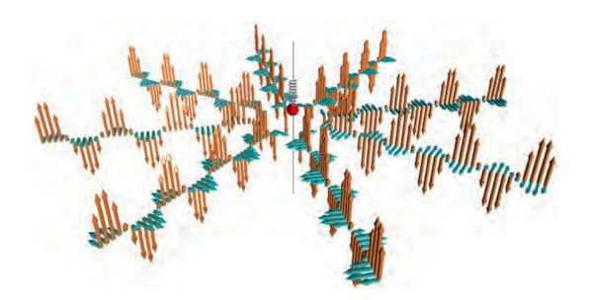
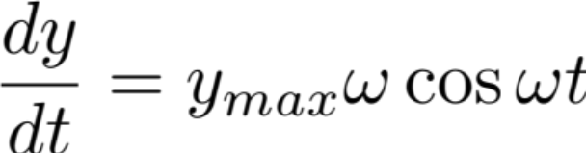
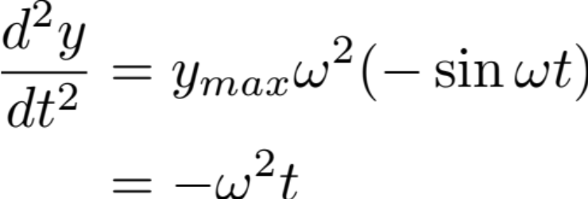

Radiation Field Due to Sinusoidal Oscillation of a Point Charge
Along x (or more generally, along r):
Φ is the initial phase angle of the oscillation
Fix :

Slide 6
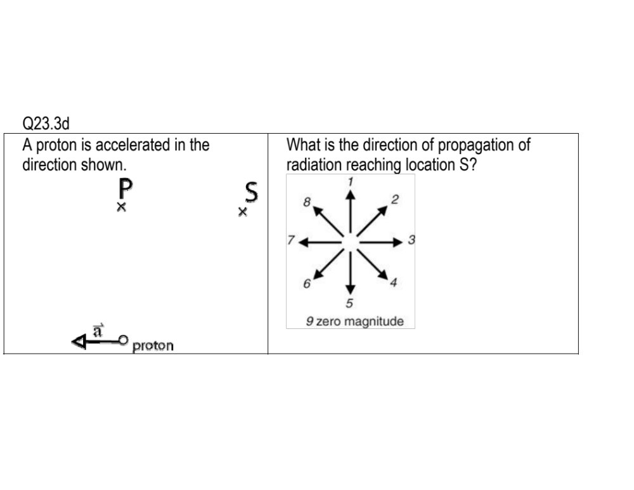

Slide 7
