Slide 1
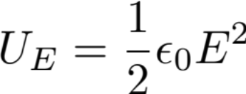
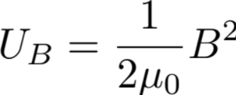
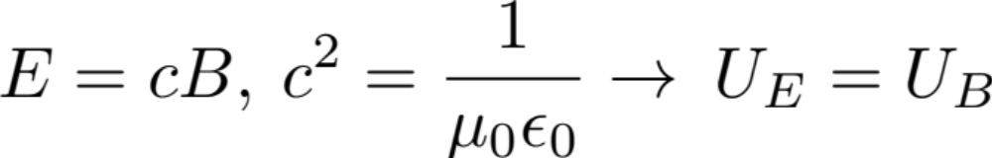
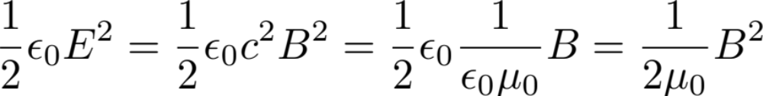
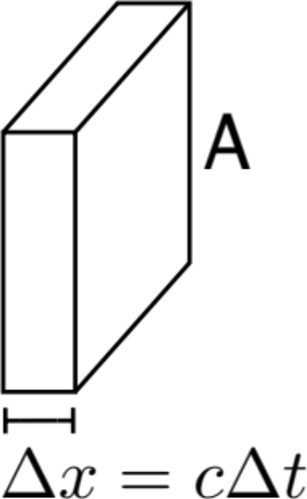
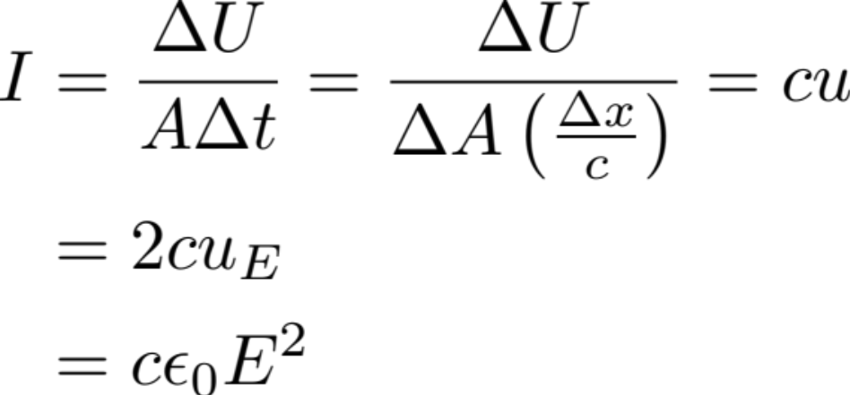
Lecture 38
Radiation Energy Density
EM Wave:
Equal partitions:
Intensity:

Slide 2
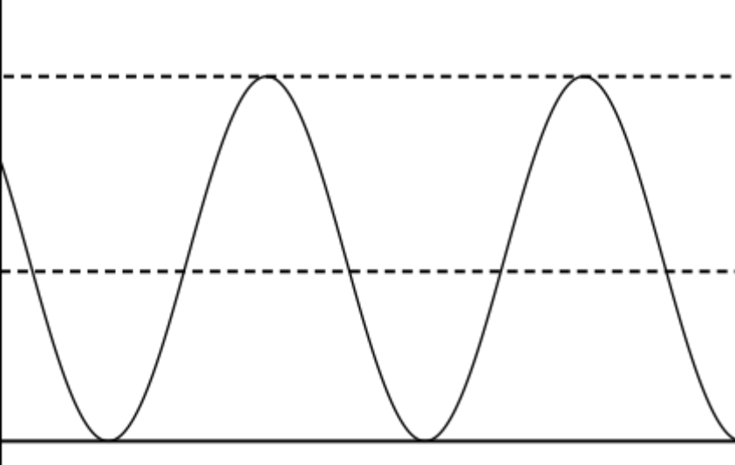



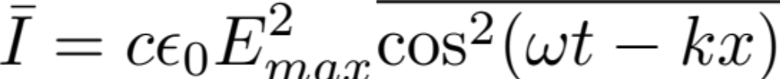
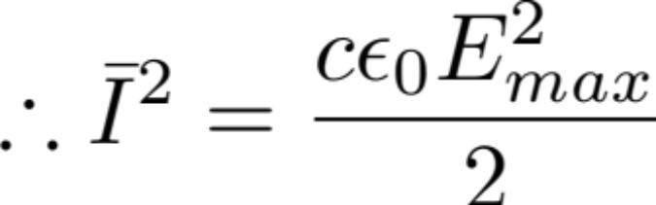
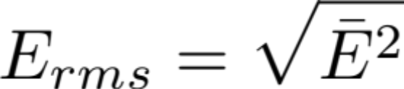
Time dependence of I at x = x₀:
Time averaged value:

Slide 3
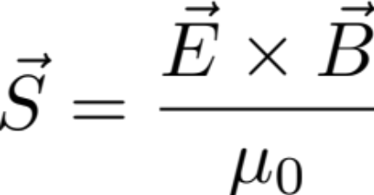
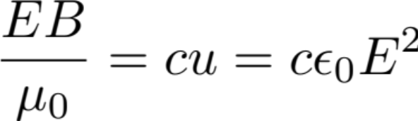
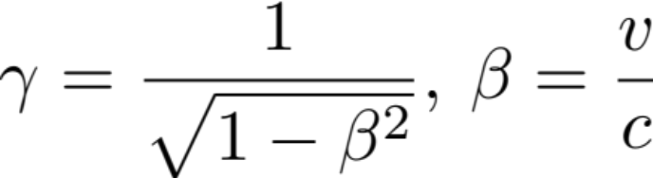
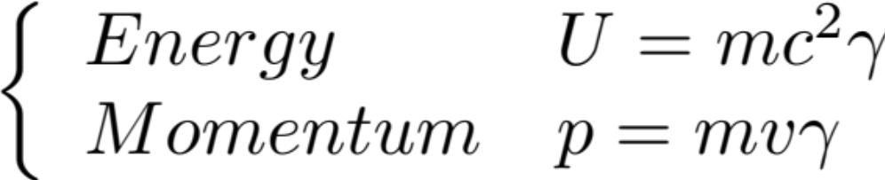

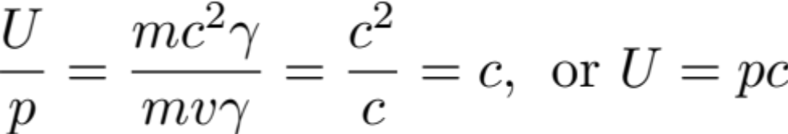
Intensity Vector (Poynting Vector)
Show that:
Energy-Momentum Relationship: Relativistic Kinematic
For a particle will mass m:
Light particle: photon

Slide 4
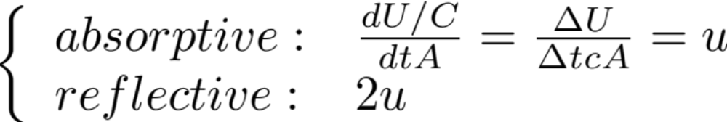
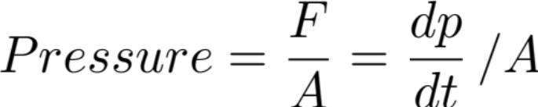

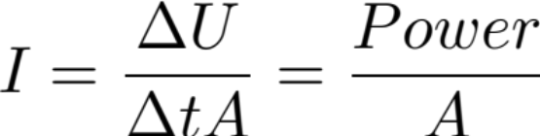
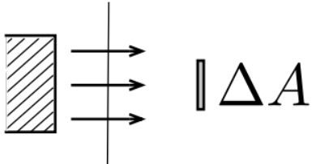
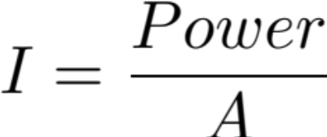
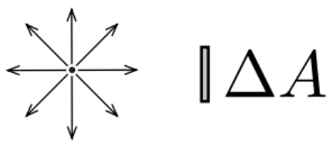
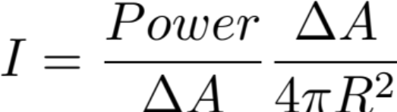
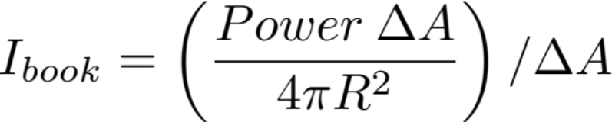
Radiation Pressure
Geometry Dependent A: Reflective Example
Geometric consideration:
Light beam shining on a book:
Bulb shining on a book:

Slide 5
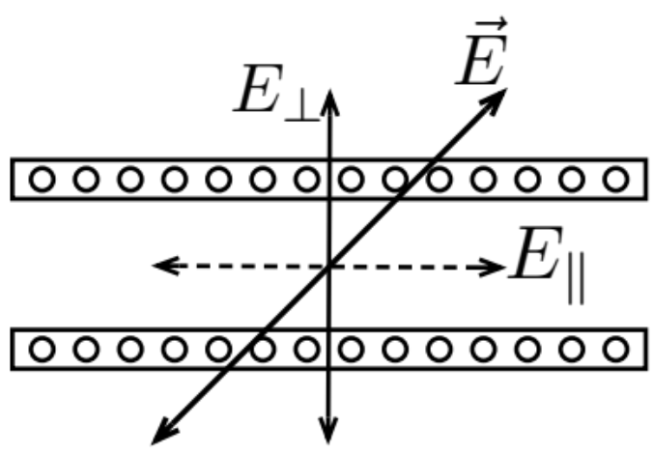

Polarization
Define: Direction of polarization = direction of oscillation of E
Metal perpendicular strips:
E-parallel drives electron oscillation
Large induced current
Energy absorbed by medium
E-perp. Negligible induced current
This component can be transmitted
The strip setup serves as a polarizer.
If the incident light is unpolarized (i.e. polarization is uniformly distributed in the azimuthal direction) the outgoing light will be polarized in the vertical direction – direction of E-parallel
If the incident light is polarized along E where there is angle θ between E-perp and E, then E-perp = E cosθ,
Outgoing Intensity:
This is Malus’ law.

Slide 6
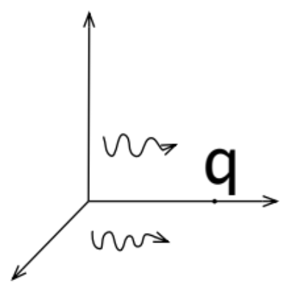
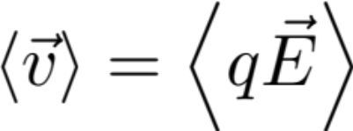
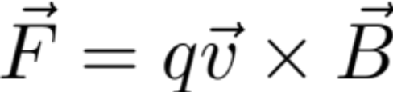


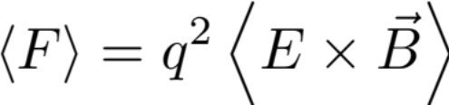

Metal Strip Analyzer
Rotating the strip can check polarization of the incident light.
Unpolarized incident light, if no variation in intensity
Unpolarized light may be represented by two equal weight mutually perpendicular polarized lights
Two mutually perpendicular analogues can fully block out an polarized light
Radiation from a charged particle initially at rest:
Direction of magnetic force on q initially at rest:
 | q > 0 | q < 0
1) | Left | Left
2) | Right | Left
3) | Left | Right
4) | Right | Right
HINT:
Notice:

Slide 7
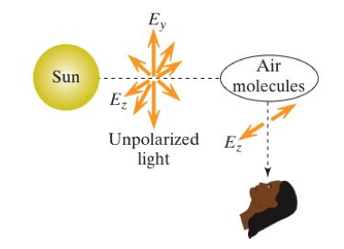
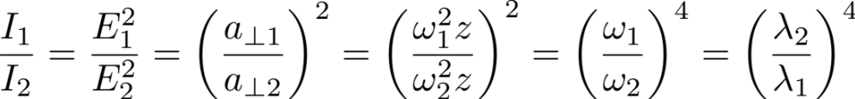
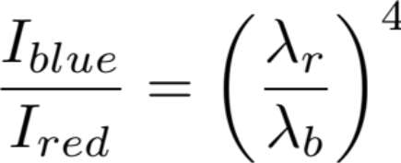
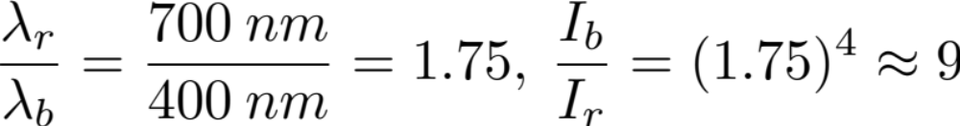
The polarized sky light
Sunlight: Unpolarized light
Rescattered light observed by ground observer is polarized along z
Fig(mi) 24.51
Intensity of scattered light:
Compare Intensity of rescattered light with frequencies ω₁ and ω₂:

