Slide 1
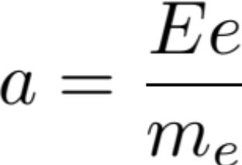
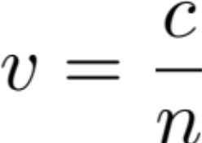
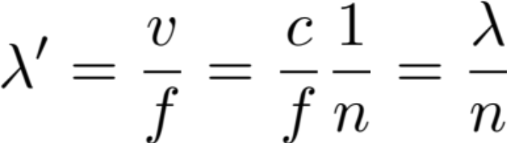
Microscopic Point-of-View:
Lecture 39
Interaction between EM waves and the medium
  Specifically; with electrons in the medium:
Resultant electric fields are complex
  original field, radiation field, re-radiation field...
Macroscopic Description
Light wave + Wave front
Light particles (photons) speed in medium:
  n = index of refraction
Wavefront
  f = f’ (determined by oscillating frequency of original source)

Slide 2

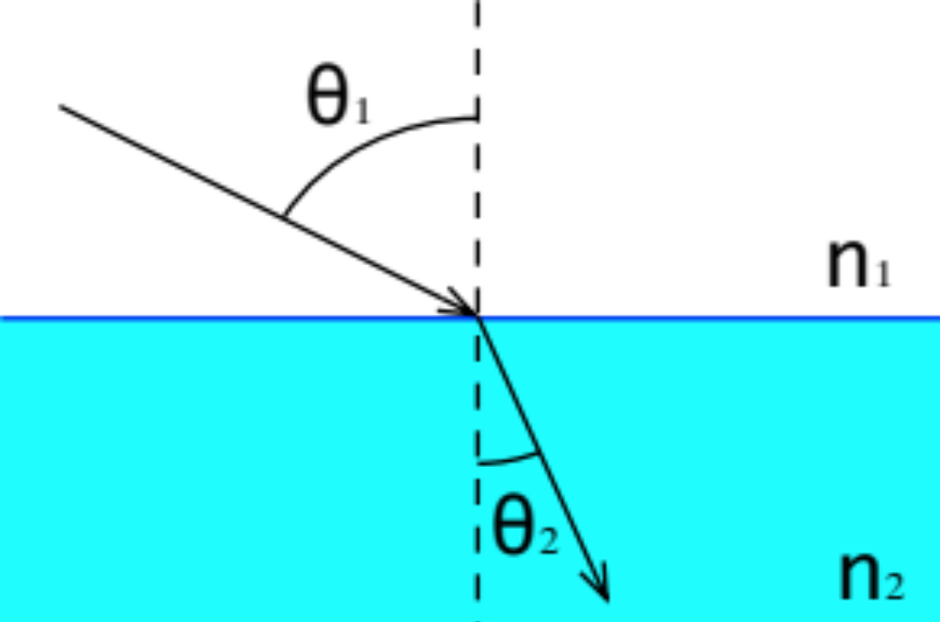
Refraction Phenomena
Snell’s Law:

Slide 3
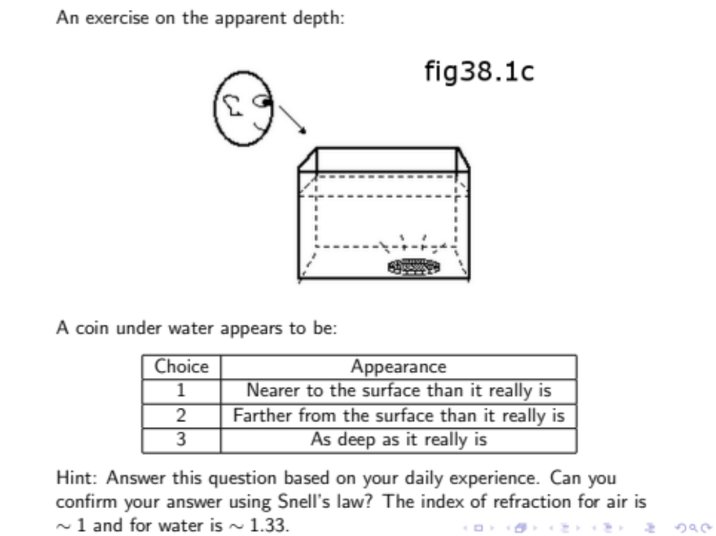
Clicker IQ 38.1c

Slide 4
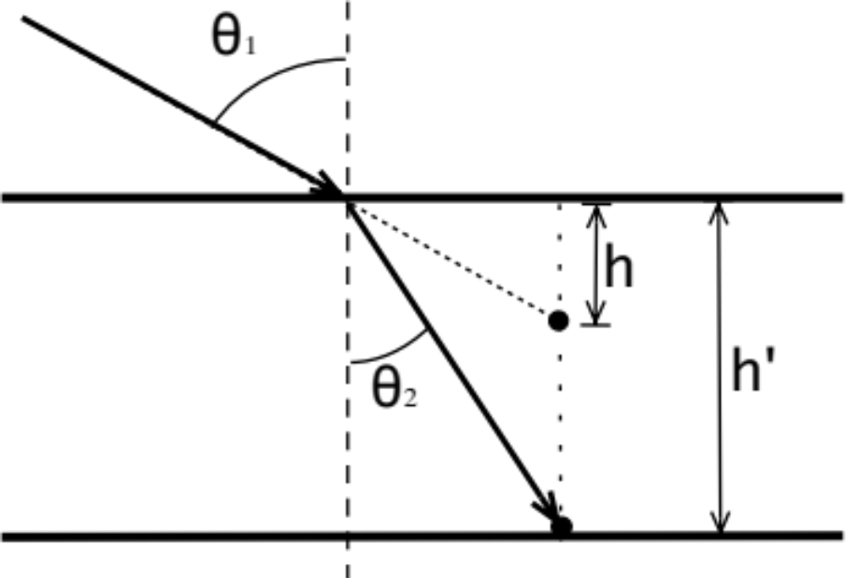
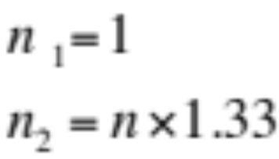
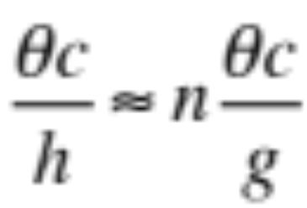
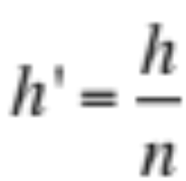
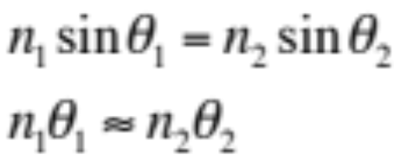
Clicker Question Explanation
from IQ Library
I.Q. 36.1c
Explanation:
Small angle approximation

Slide 5
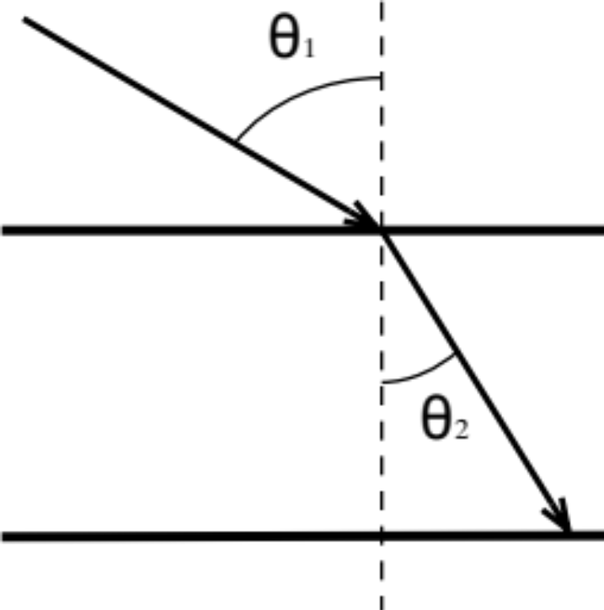
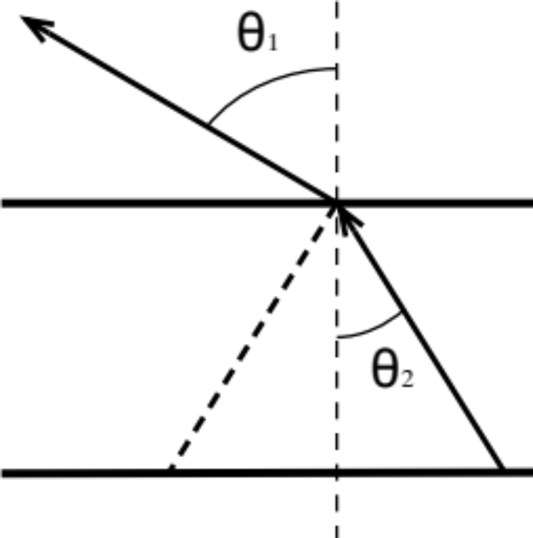
Total Reflection Region
Time Reversed Situation

Slide 6
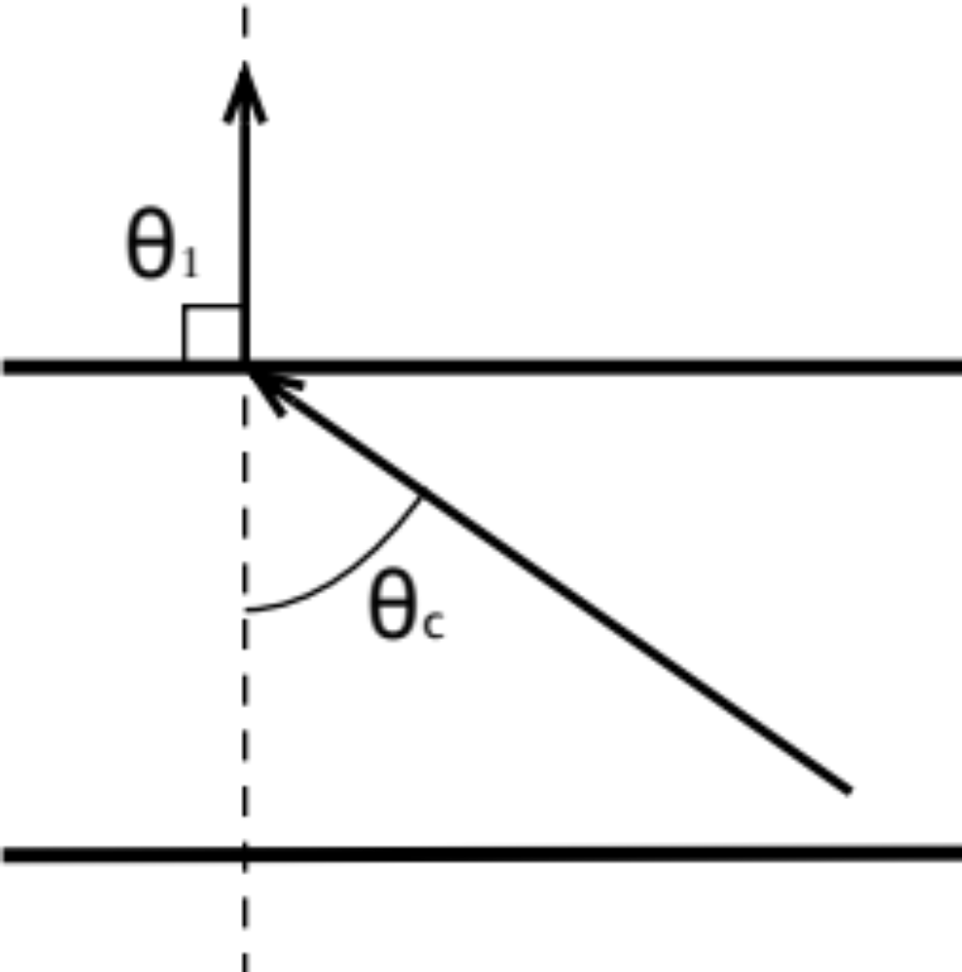
Reflection/Refraction Critical Angle
As θ₂ increases, θ₁ increases more rapidly
At critical angle, θ₂ = θ_{c}
θ₁ = 90°

Slide 7
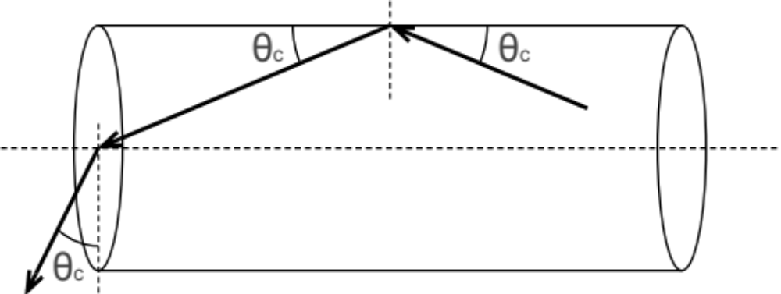
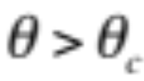
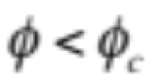
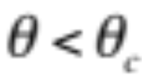
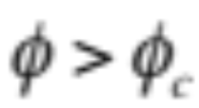
Application: Optical Fiber [Ch24.HW4.009]
Total reflection region

Slide 8
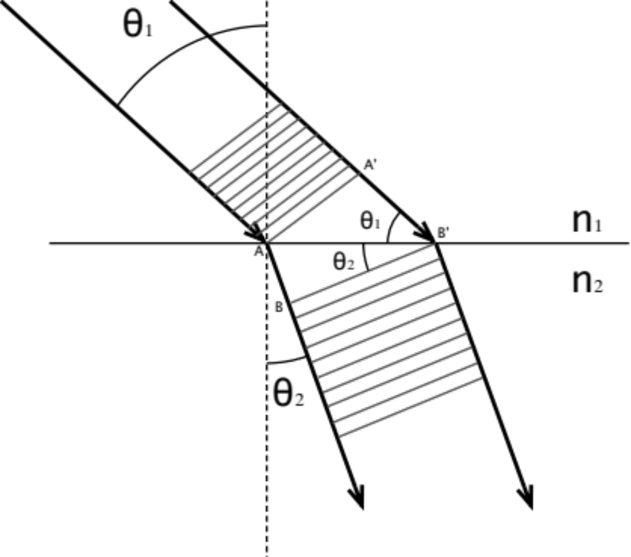
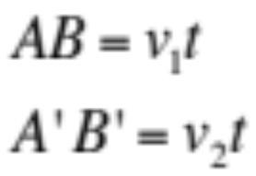
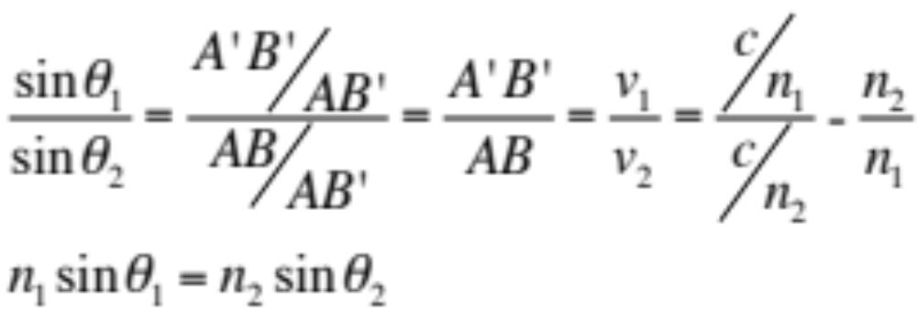
Derivation of Snell’s Law

Slide 9
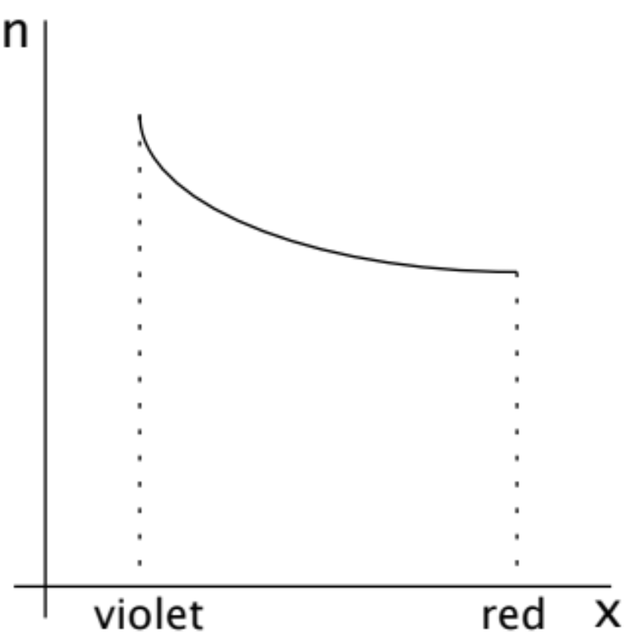
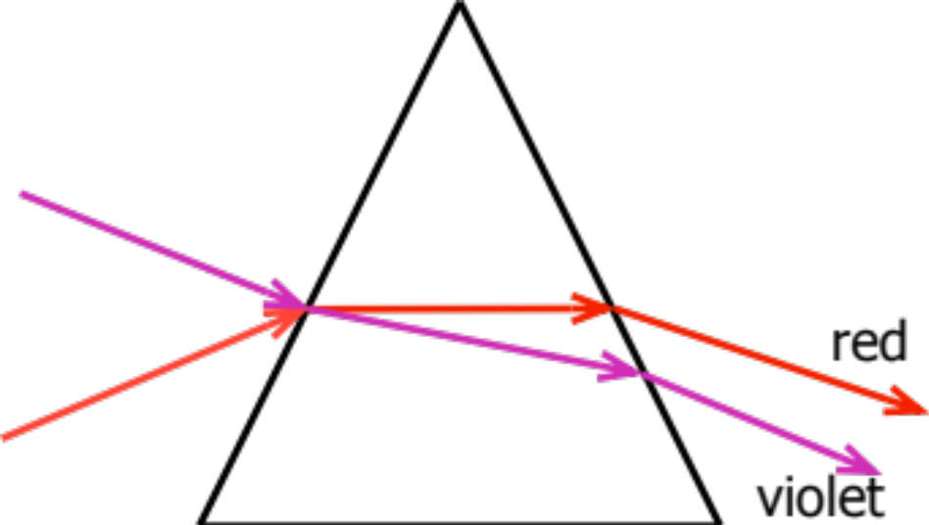
Prism
Color Dispersion
At each surface, the light ray is bending
Violet light has more bending than red

Slide 10
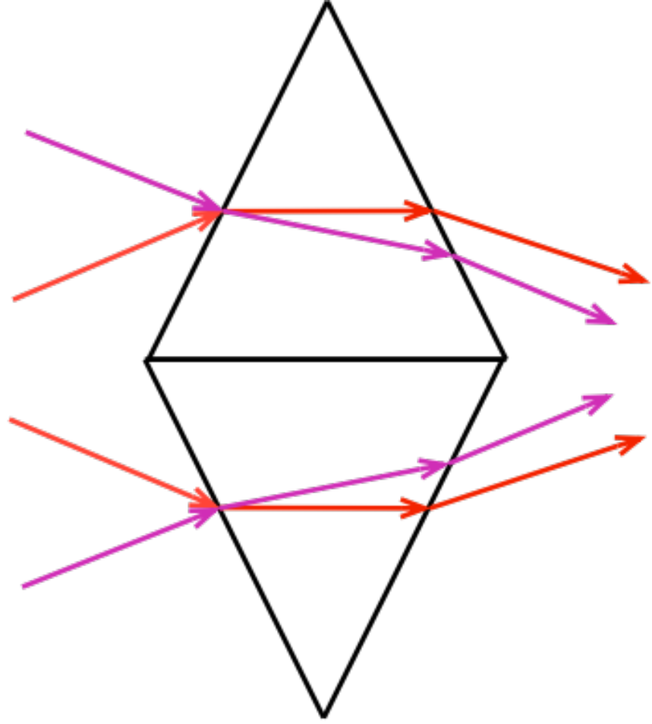
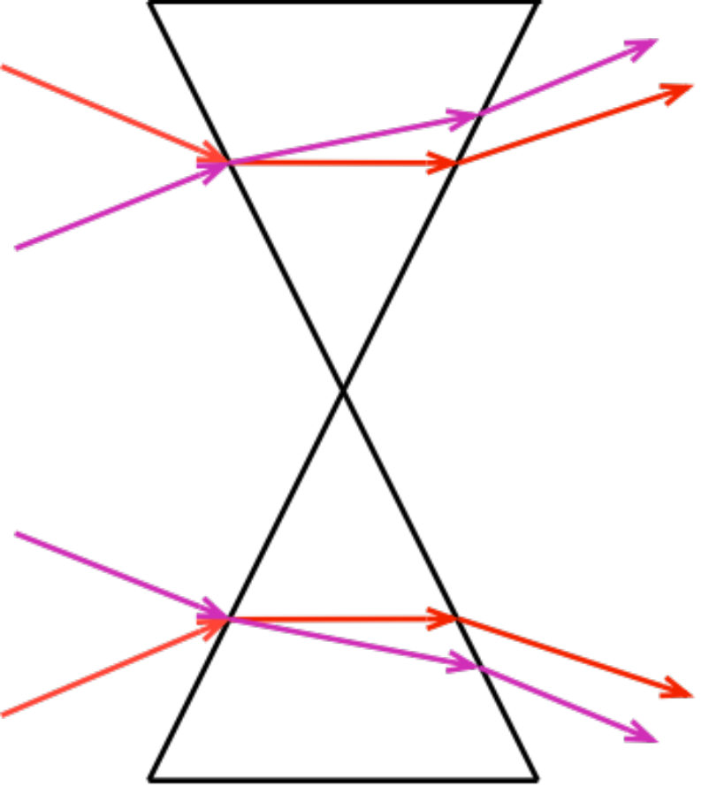
Two Prisms
Convergent
Divergent

